Slide 1
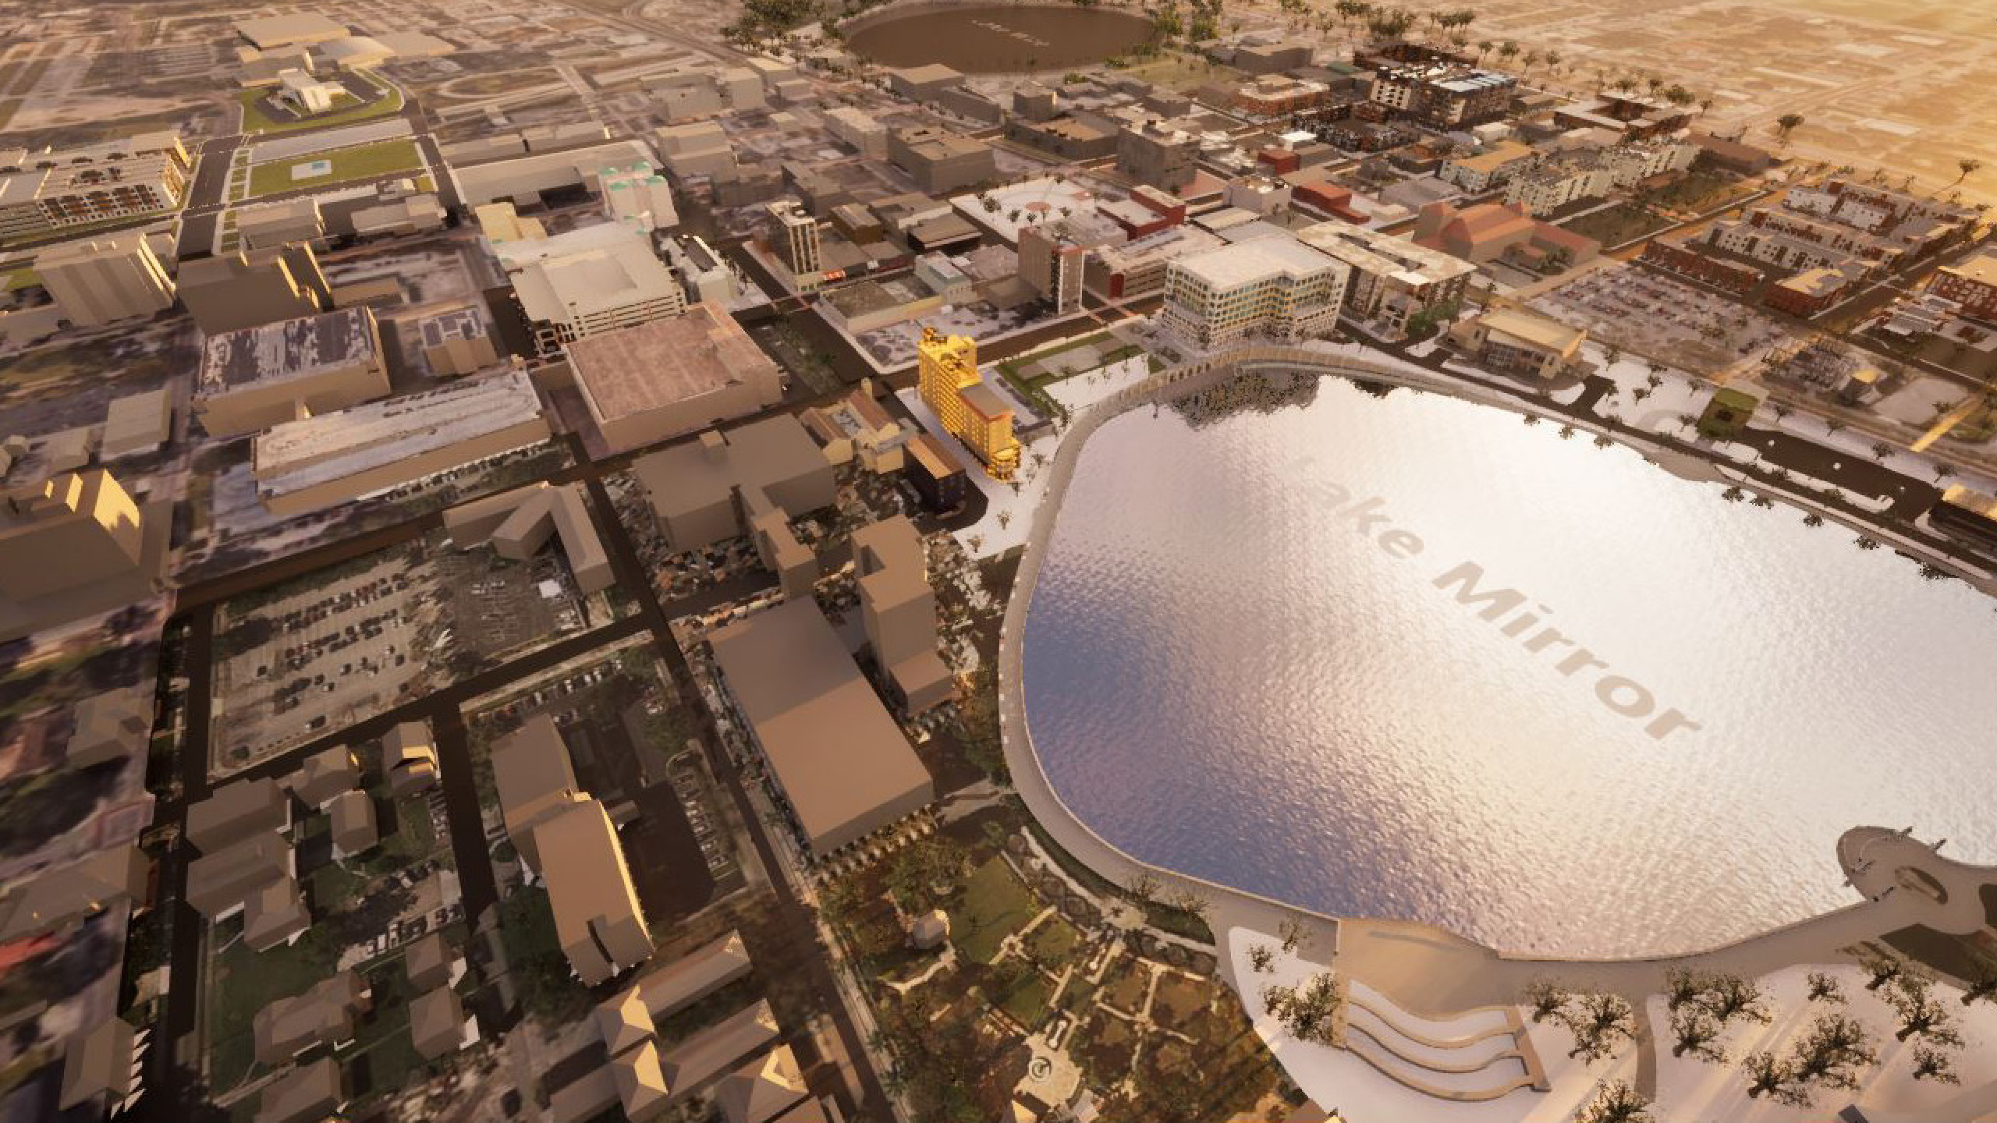


A VISION FOR LAKELAND
powered by

Slide 2
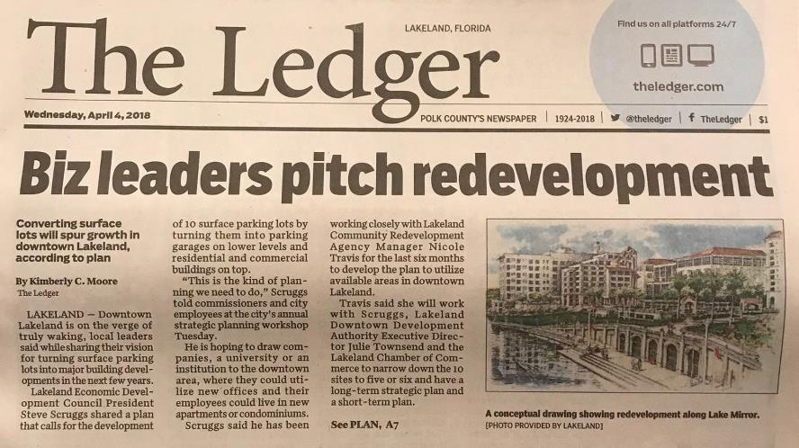
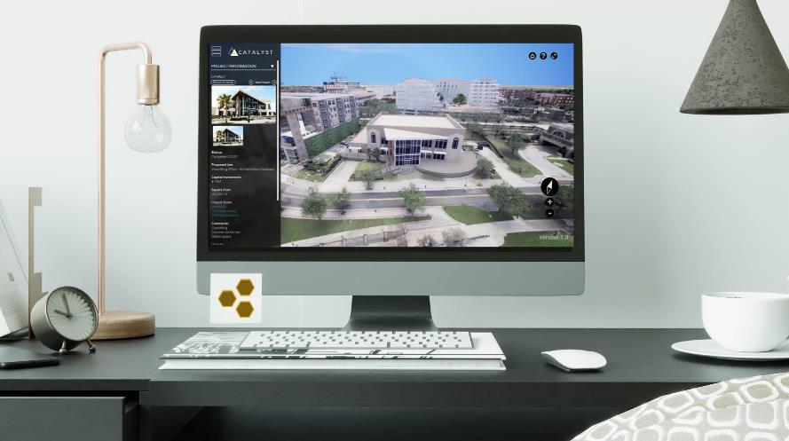
FROM THIS...
...TO THIS.

Slide 3
TOURING
CATALYST

Slide 4
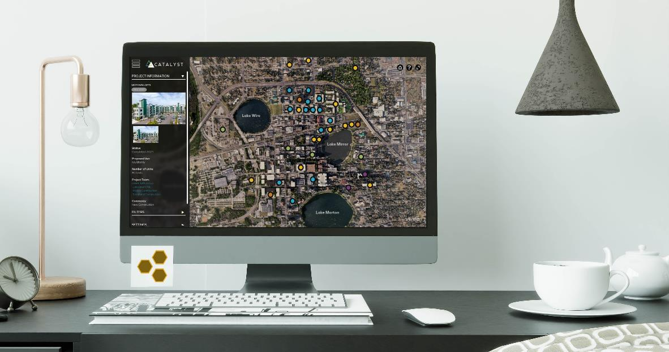
AERIAL VIEW

Slide 5
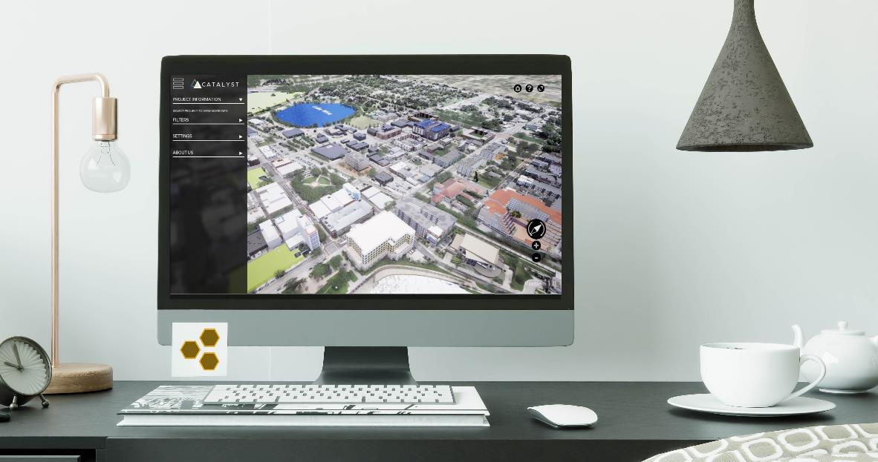
AERIAL VIEW

Slide 6
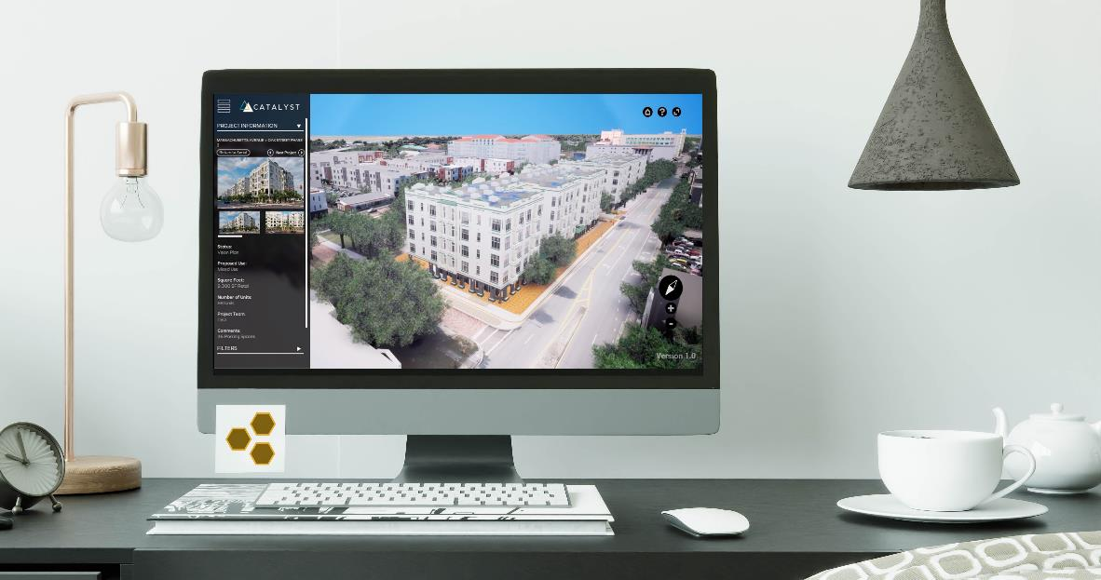
360 VIEW

Slide 7
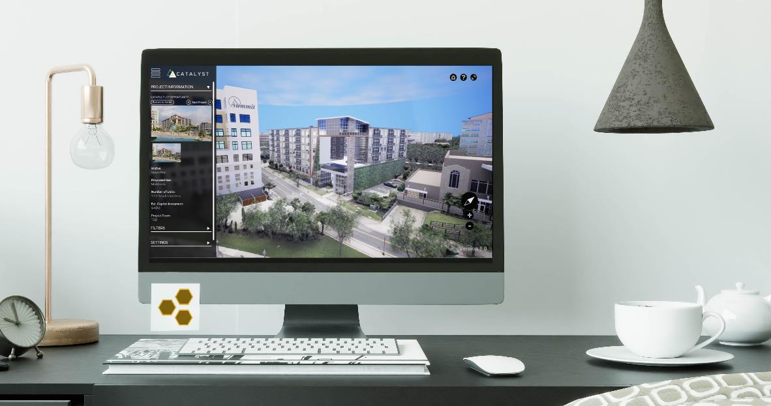
360 VIEW

Slide 8
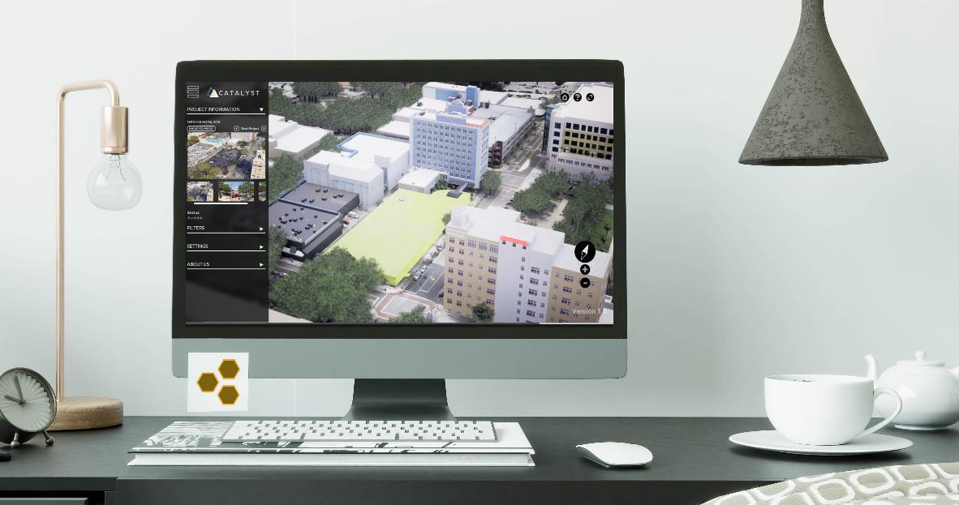
OPPORTUNITY AREAS

Slide 9
INVESTING IN OUR
FUTURE

Slide 10
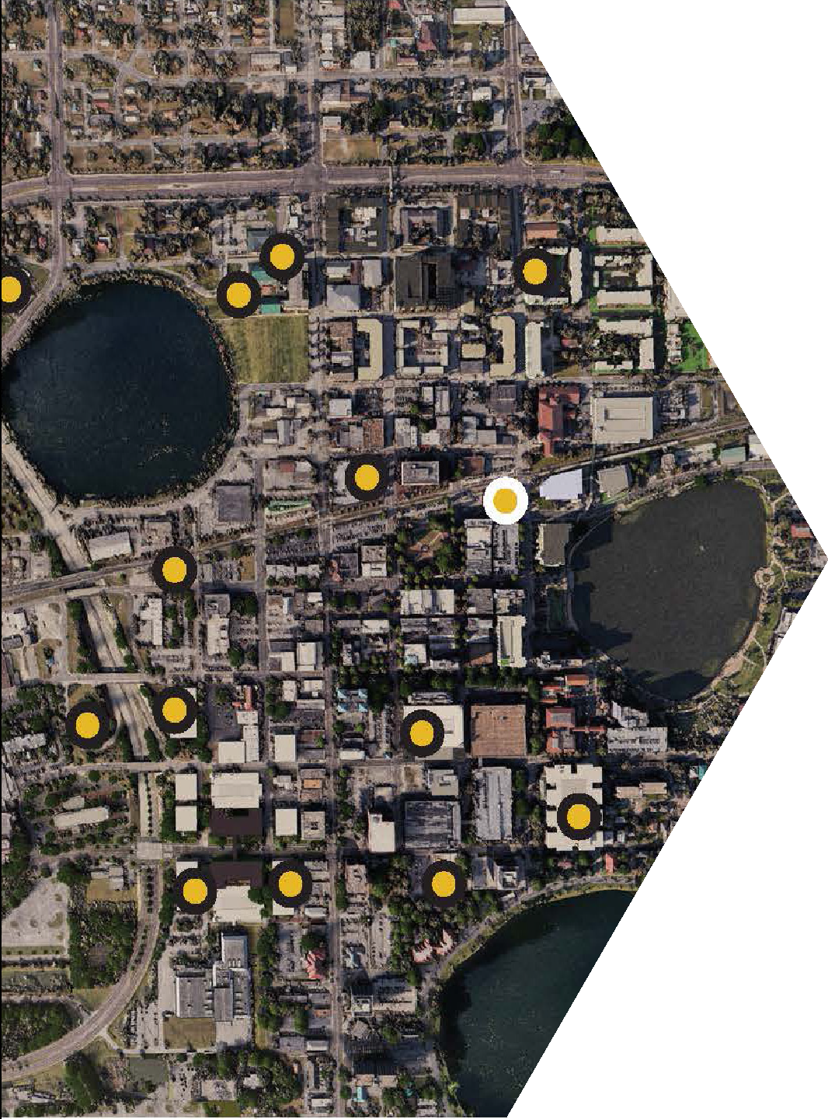
CURRENT
CAPABILITIES
3D Project Showcase
Highlight Potential Investment Opportunities
Ability to Filter Projects by Type/Use
Showcase New Developments
Community Engagement
High Level User Interface Capabilities

Slide 11
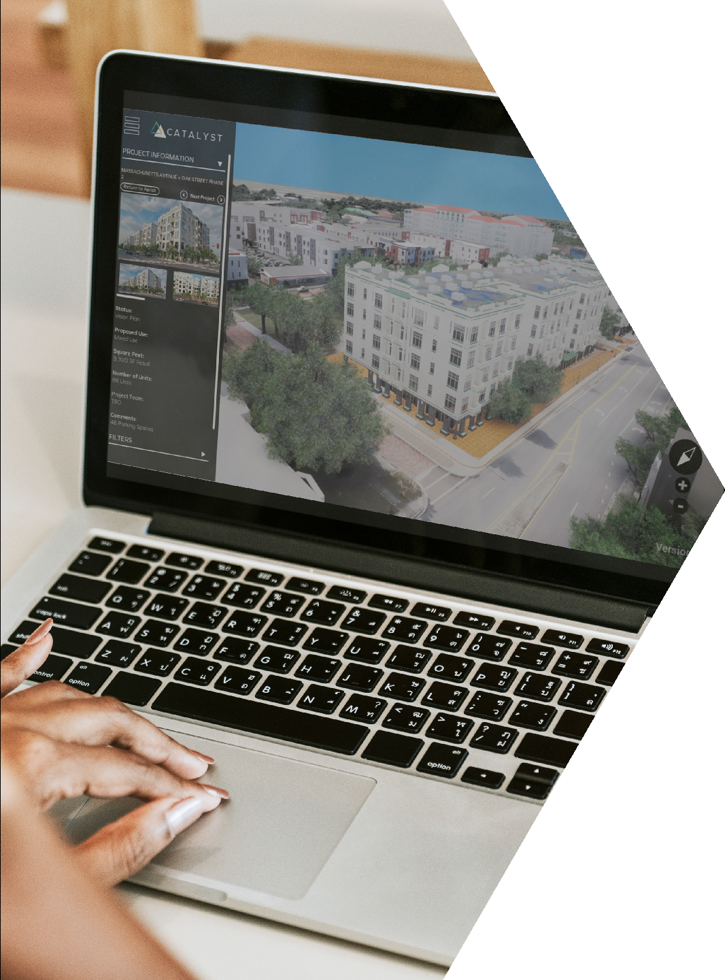
PROJECTS
ON DECK
Per our current approved task authorization, The Apiary is ready to fulfill the following outstanding tasks upon completion and delivery of assets for the following visioning projects:
West Downtown
Dixieland
East Main District
Additional Vision Projects (6)

Slide 12
TASK AUTHORIZATION
PHASE 3
Target Completion: September 30, 2023
CRA Share - Platform Hosting | $10,000
Data and Asset Collection | $15,175
Completed projects over last 3 years
Under Construction
Permitting/Design
Available sites and static vision
3D/Interactive Vision
New Vision Projects Design (6) | $50,425
Placing Plans into the Model (9) | $24,400
TOTAL | $100,000

Slide 13
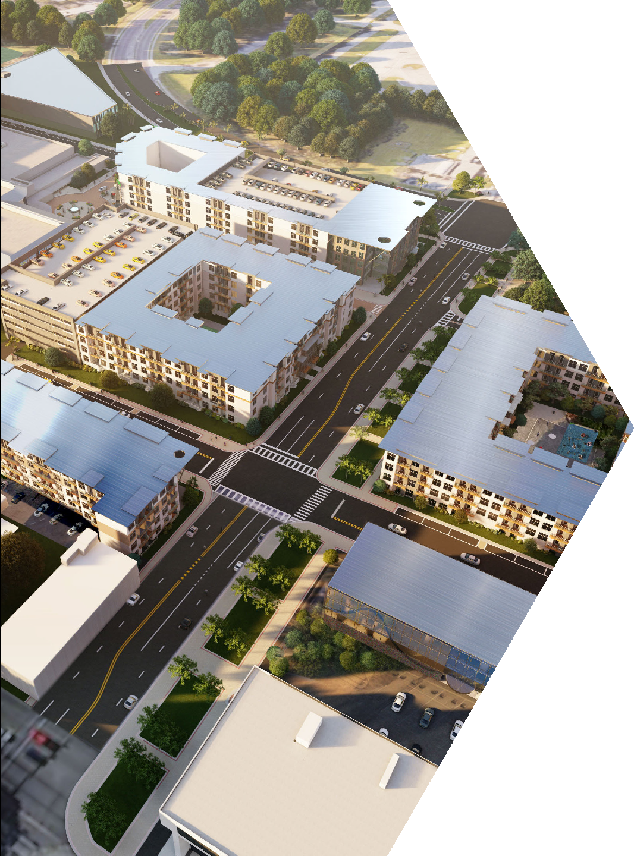
CREATING
CERTAINTY
Potential future opportunities within the platform include:
Communicate Process and Policy
Outreach and Educational Components for Strategic Planning
Expansion for Investment Opportunities
Structured Parking Opportunities
Traffic Studies
Real-time Public Transportation Data

Slide 14
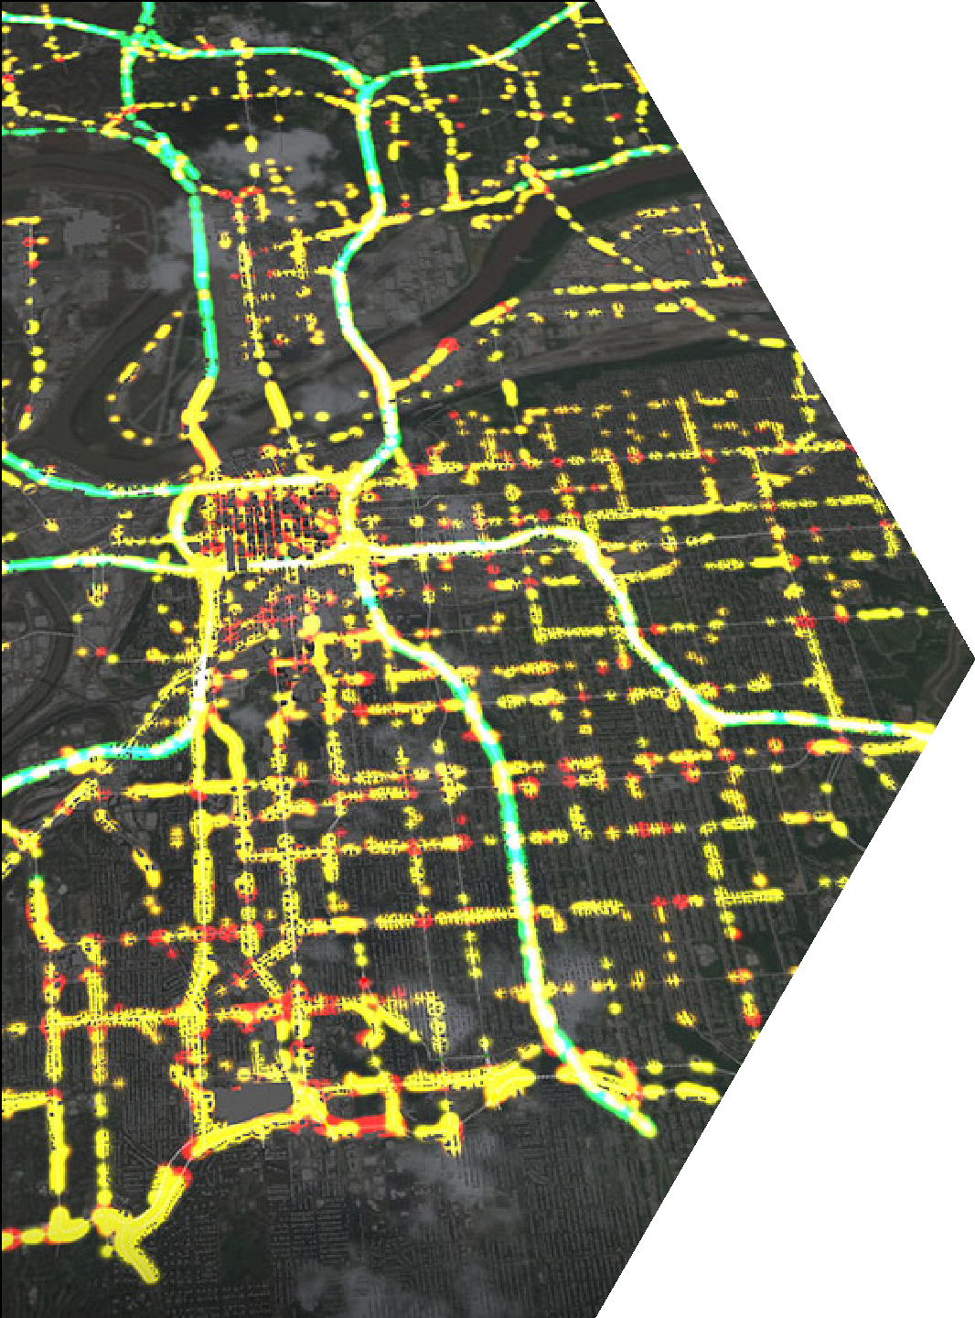
ELEVATED
EXPERIENCES
Push User Interface Design
Offer Interactive Virtual Tours
Optimization for Mobile Users
Maintenance and Hosting
Outlining Strategic Initiatives
Elevating the Community

Slide 15
QUESTIONS

Slide 16
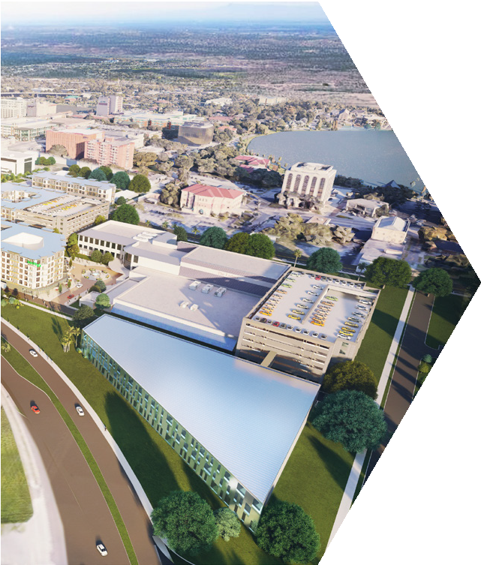

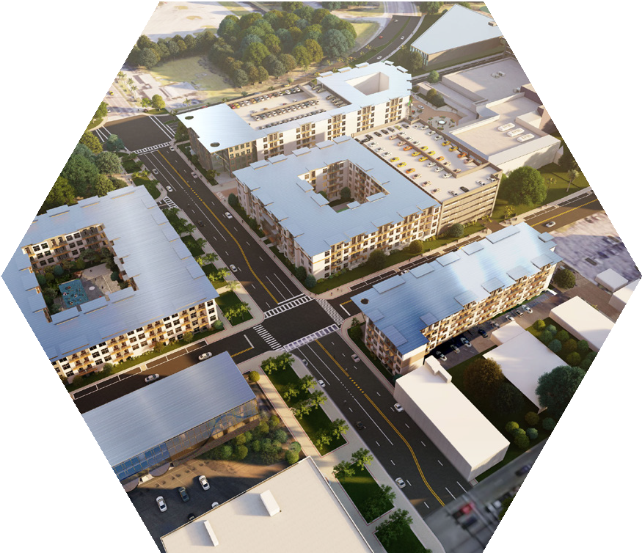
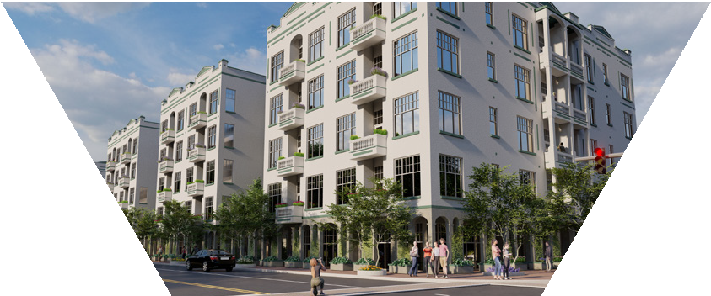
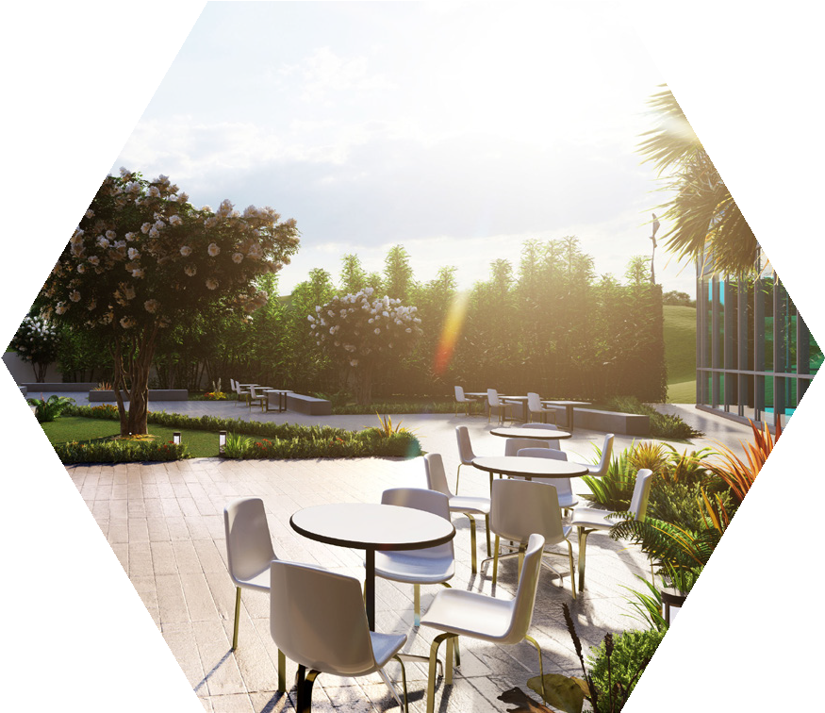
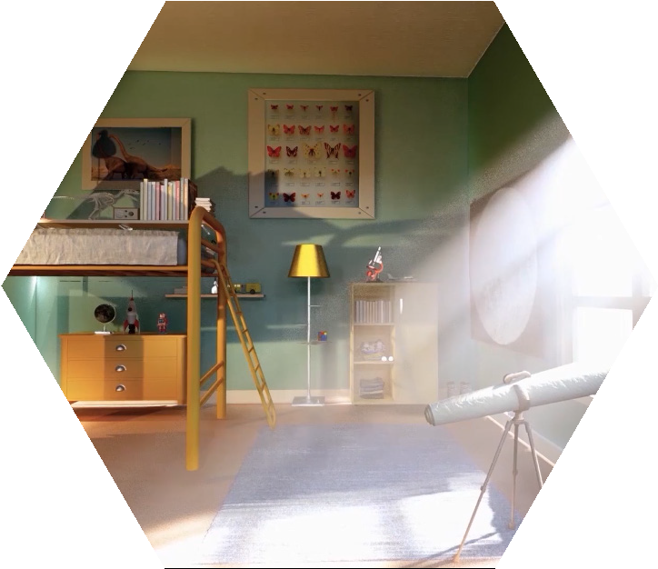
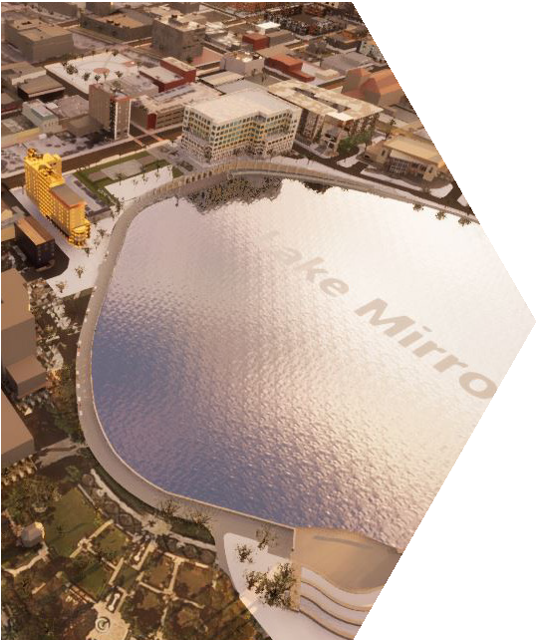

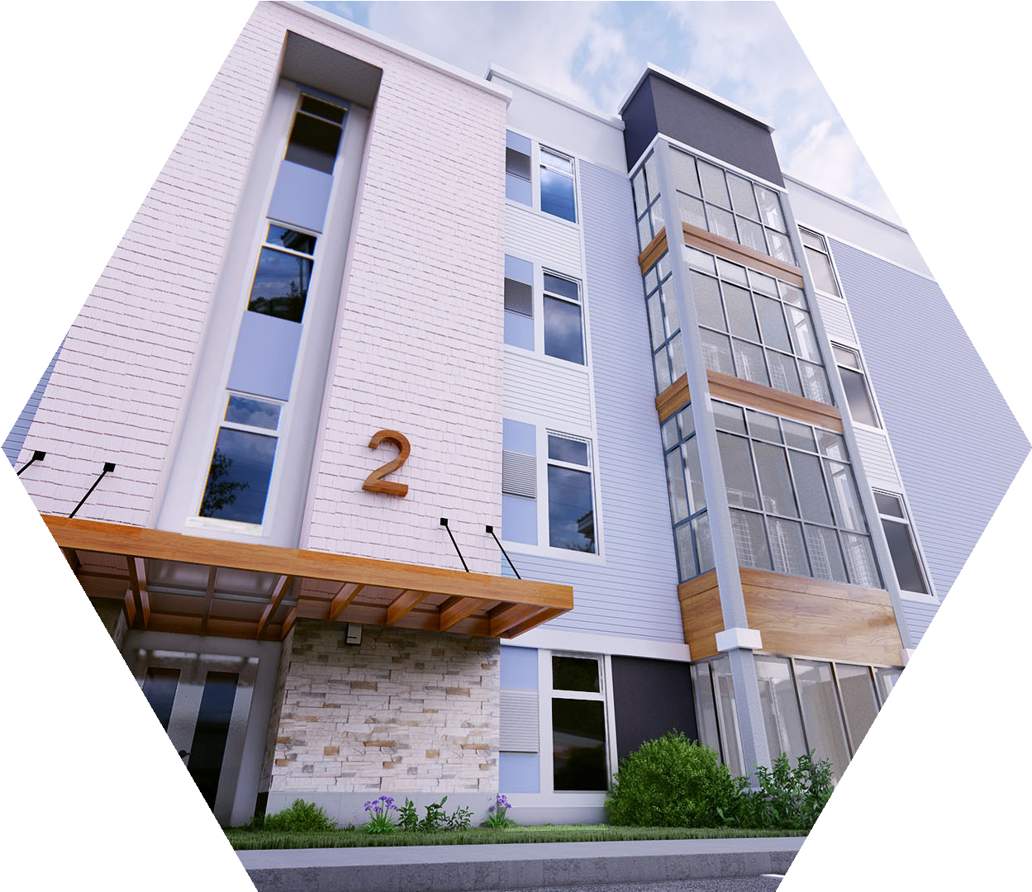
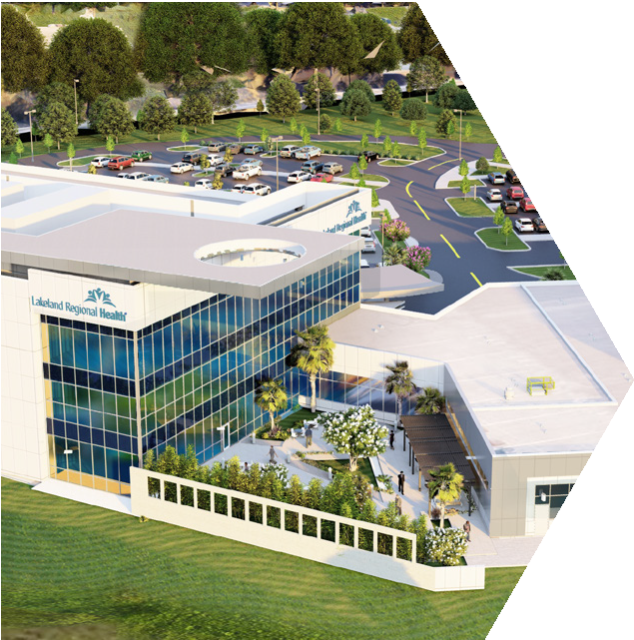
MAGGIE BRIGGS
PHONE CELL EMAIL
863.216.6495
352.516.6006
mbriggs@theapiarystudios.com

