Slide 1

Historic Preservation Board Meeting
July 26, 2018

Slide 2
Historic Preservation Board
Call to Order, Determination of a Quorum, and Roll Call
Review and Approval of previous HPB Meeting Minutes
Old Business: None
New Business:
Allow for Historic Preservation Member(s) to be appointed as alternate(s) to serve on the Design Review Committee in the absence of DRC members.
Adjourn for Design Review Committee

Slide 3
Design Review Committee
Call to Order, Determination of a Quorum, and Roll Call
Review and Approval of previous DRC Meeting Minutes
Overview of Certificates of Review administratively approved since June 28, 2018
Consideration of Certificate of Review Applications
Adjournment

Slide 4
HPB18-122 210 E. Main Street
Removal of Monument from Munn Park Historic District
Owner/Applicant: city of lakeland
Notes:
Thank you Mr. Chairman. For the audience’s information, the staff presentation begins with a background summary of the request and historical context of the subject property, then shares findings and analysis in accordance with applicable standards, and ends with the staff recommendation.

Slide 5
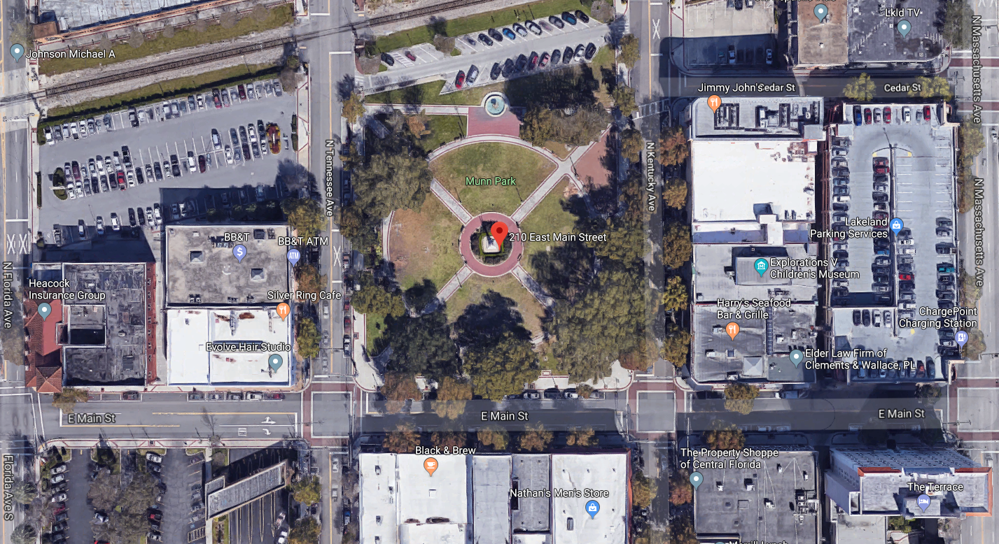
Notes:
The subject property comprises slightly over two acres at the center of downtown Lakeland and consists of Munn Park, a public park owned by the City of Lakeland.

Slide 6
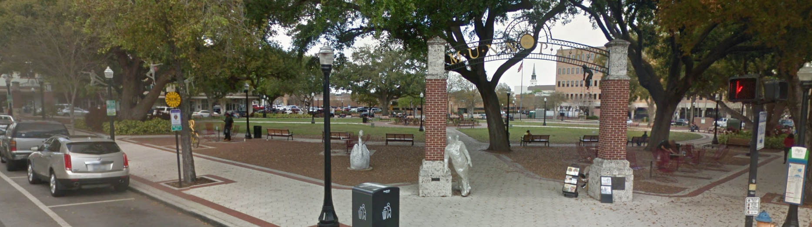
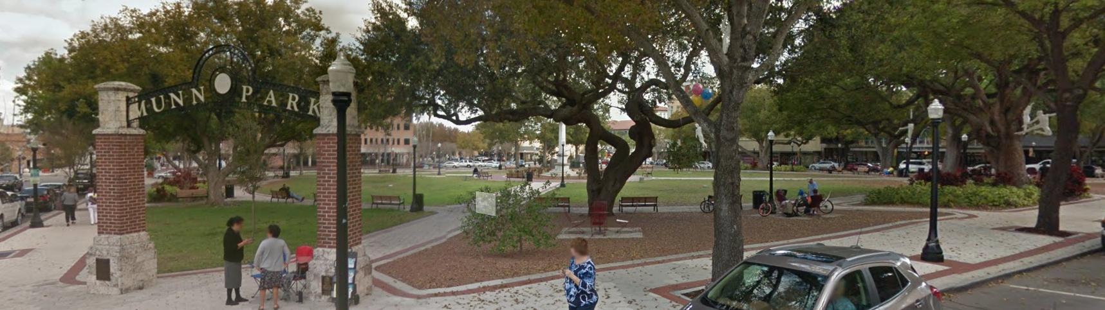
Notes:
Munn Park features passive recreational areas, walkways, park furniture, mature trees and landscaping, and a fountain at its north end. Stone and metal archways exist at the southwest and southeast corners of the park.

Slide 7
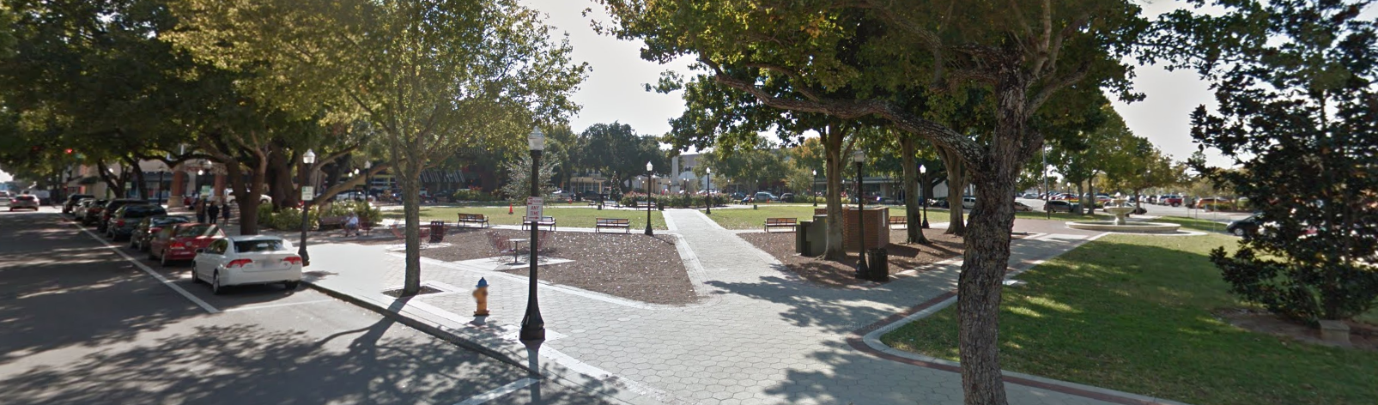
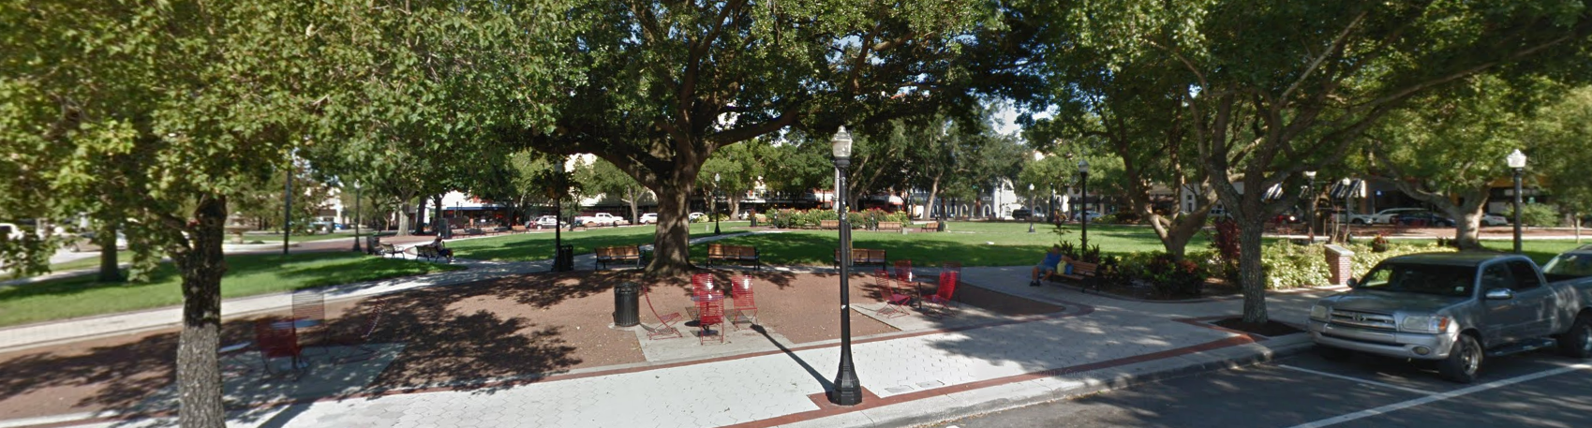
Notes:
Views of the park from its east and west sides.

Slide 8
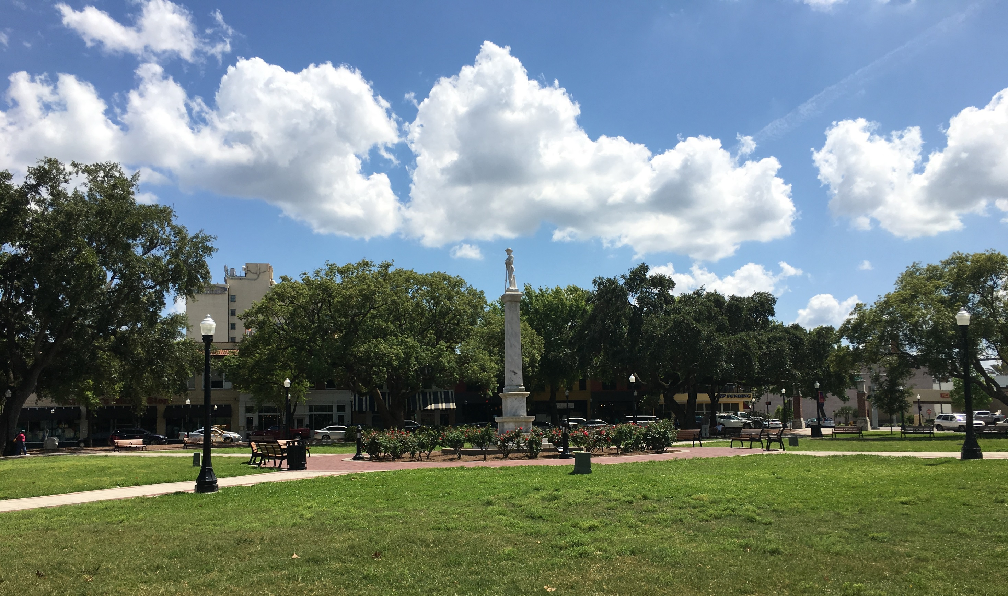
Notes:
A Confederate monument is located at the center of the park, which is 26 feet tall and consists of a marble base and statue.

Slide 9
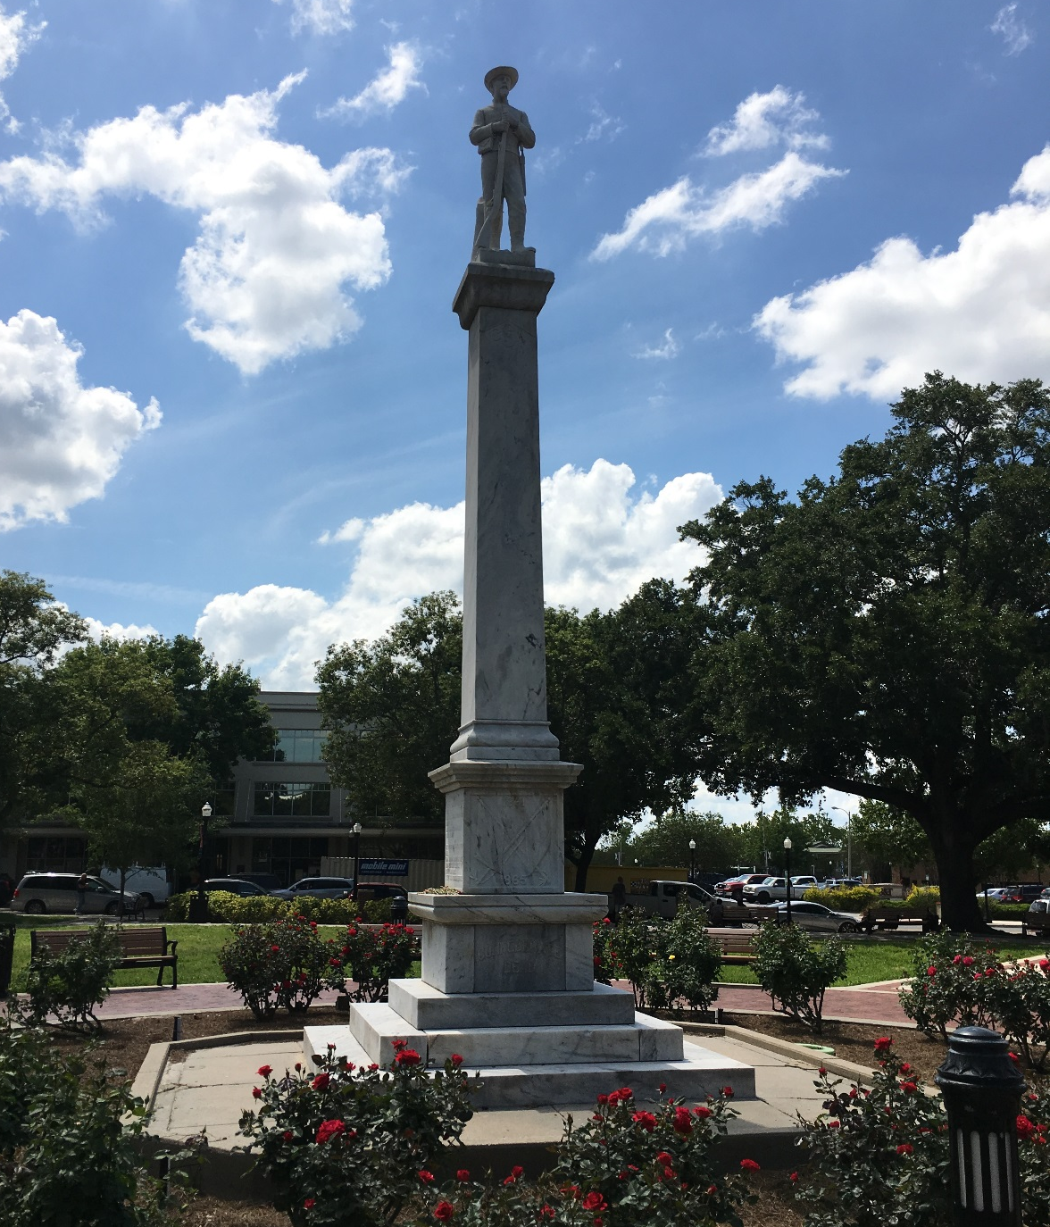
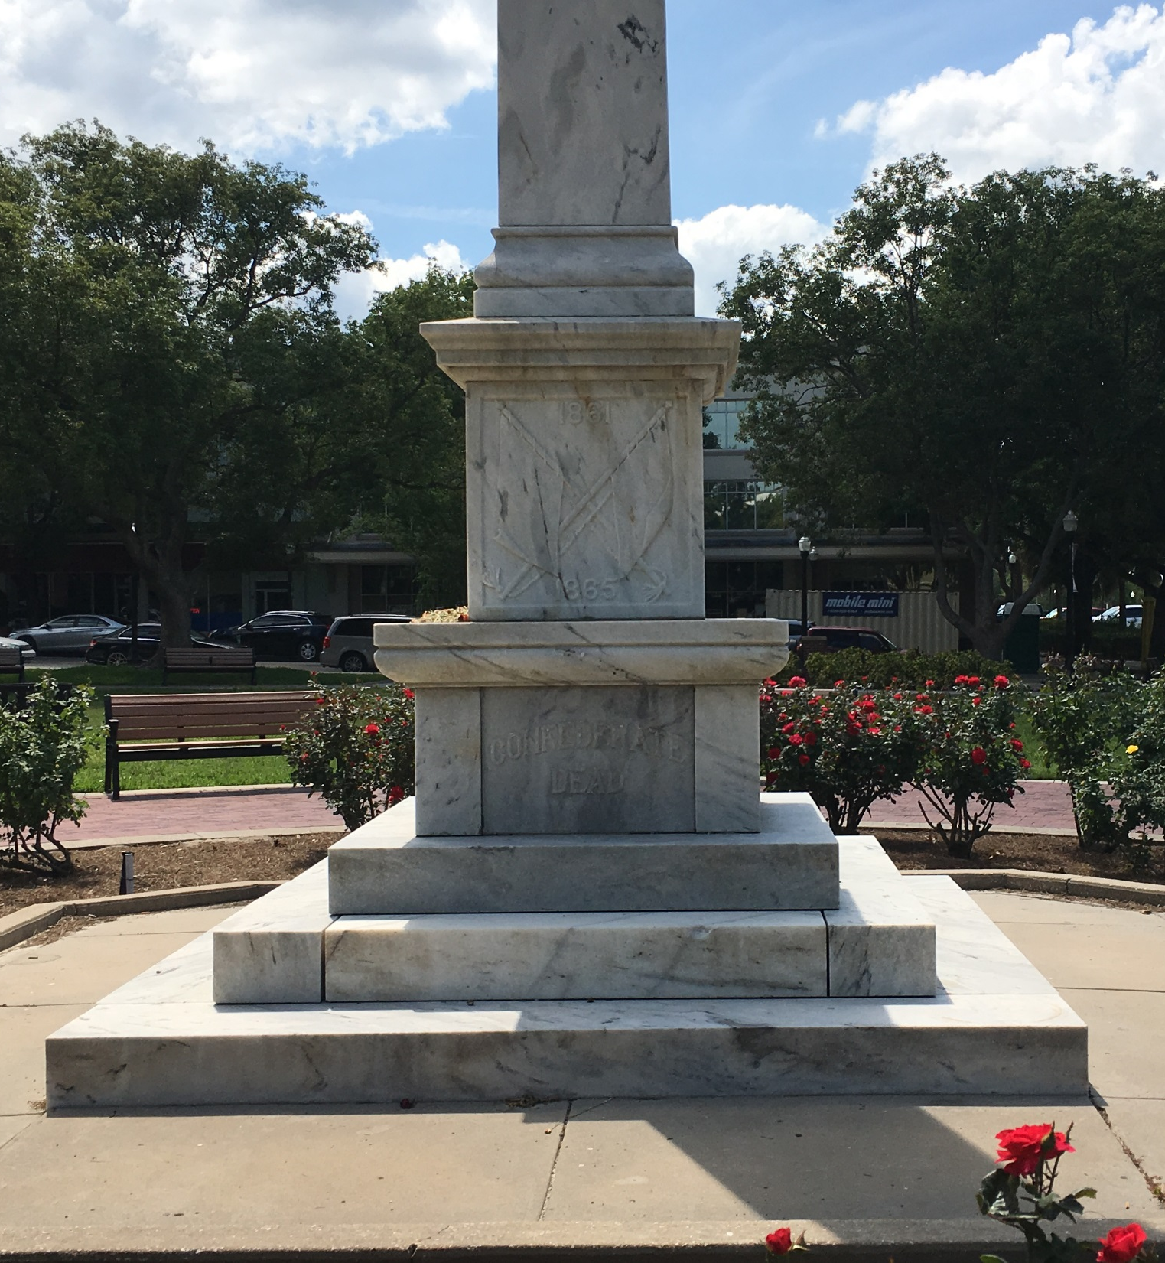
Notes:
The monument’s base is comprised of a stepped foundation, pedestal, plinth, and shaft. The east-facing statue atop the base depicts a Confederate soldier in uniform standing at parade rest, with both hands on his musket and braced against a stump. The front of the monument features a bas-relief image of two crossed flags with the dates 1861 and 1865 on its pedestal, the words “Confederate Dead” on the plinth, and the letters “CSA” engraved at the top of the shaft.
(CSA is an abbreviation used for the Confederate States of America and Confederate States Army.)

Slide 10
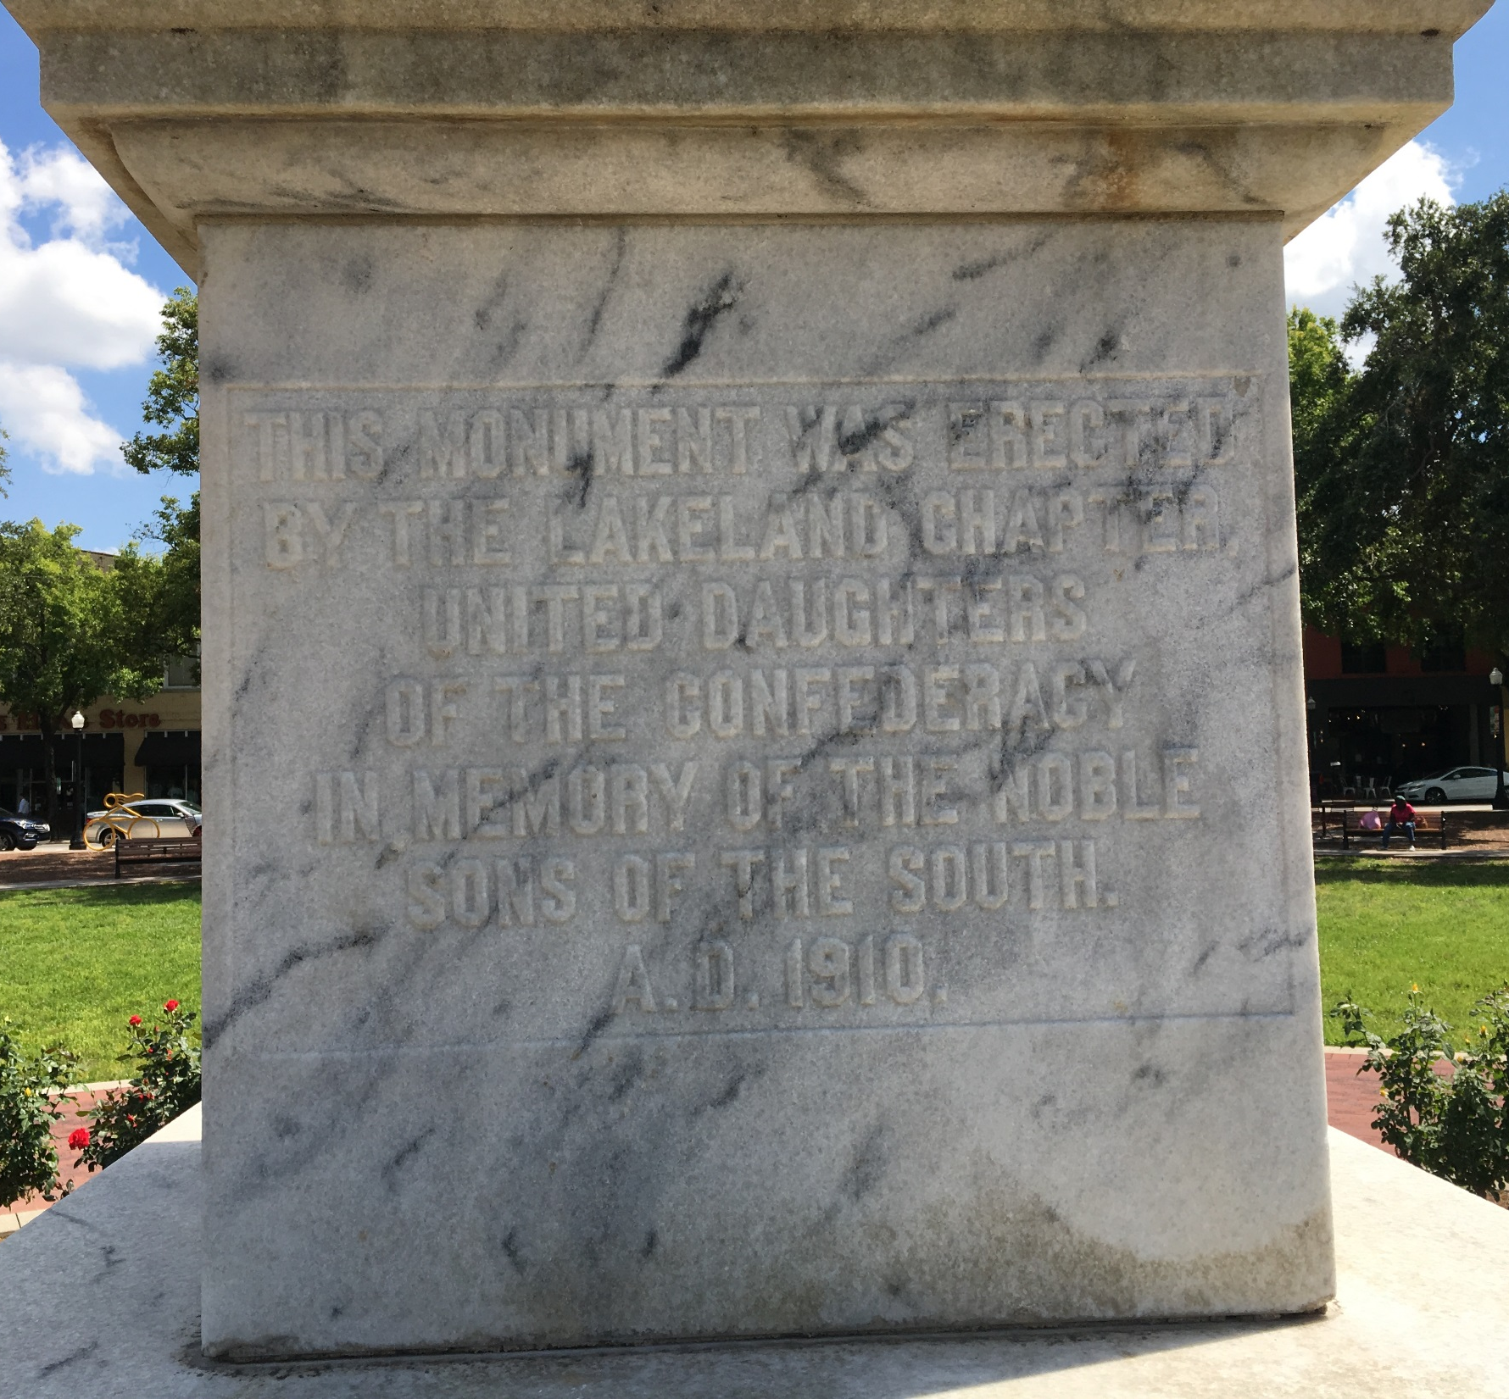
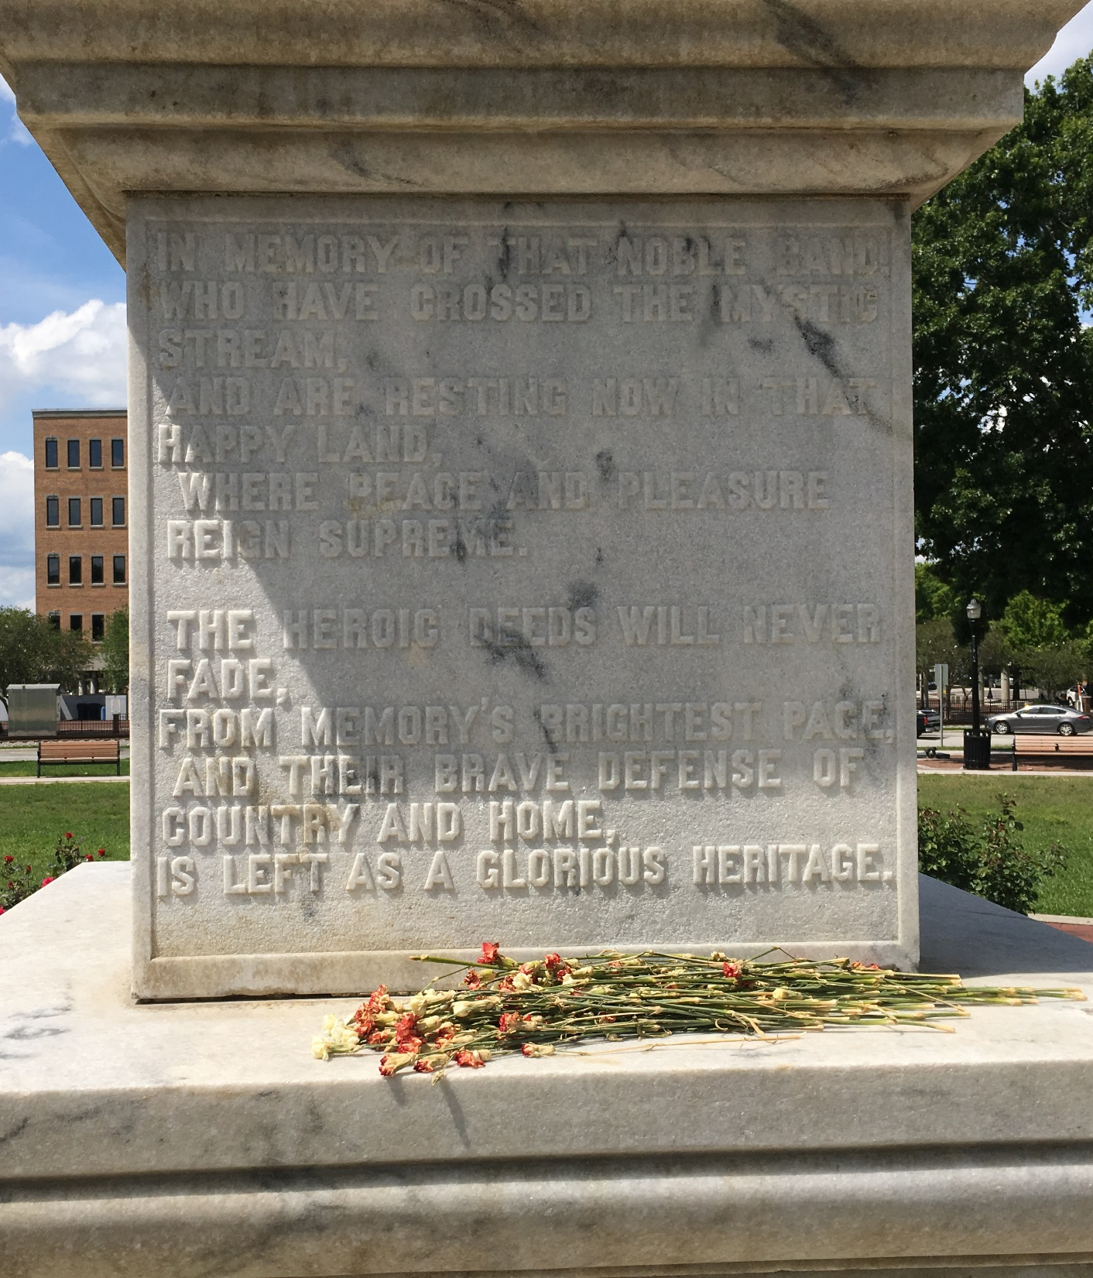
Notes:
Inscriptions also exist on the north and south faces of the pedestal as seen on this slide.

Slide 11
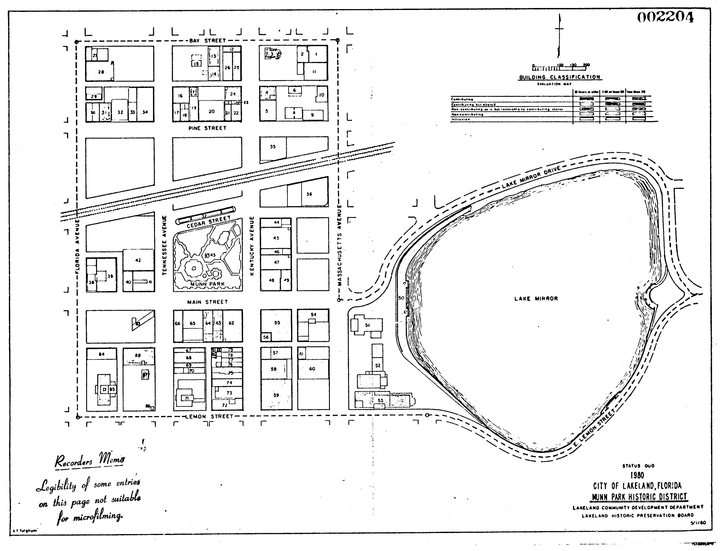
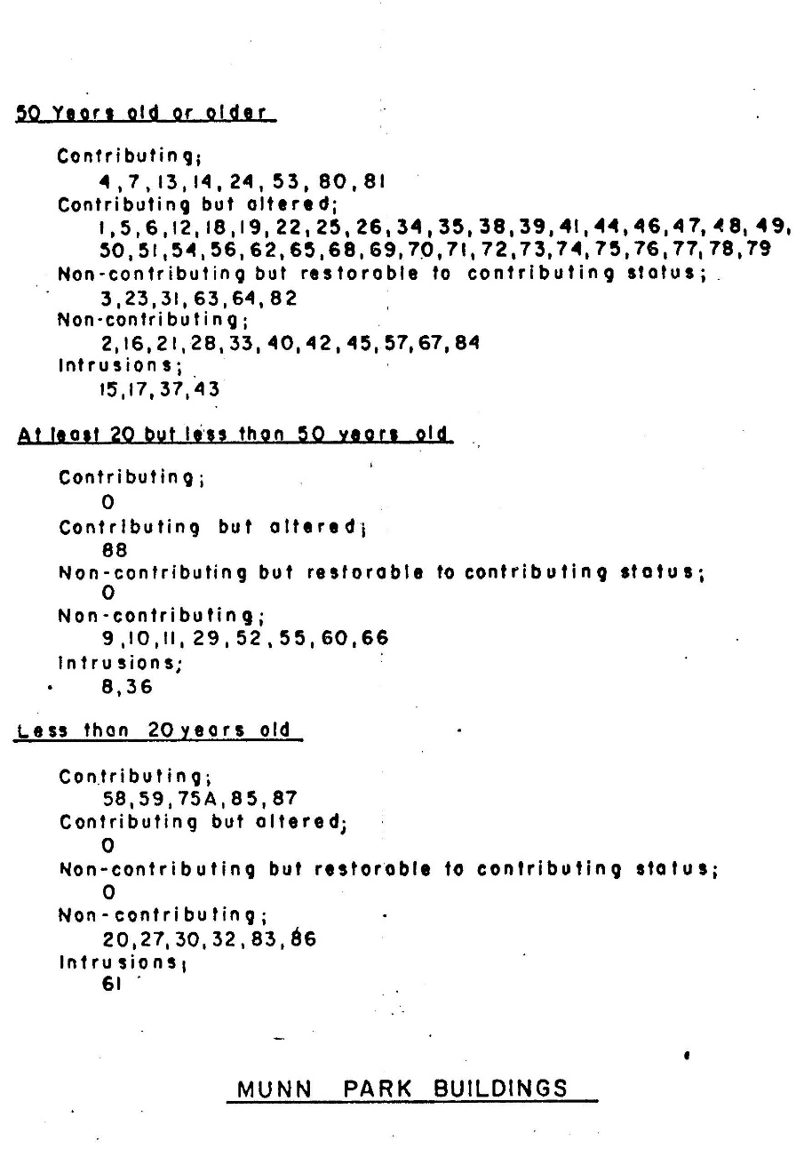
Notes:
The Munn Park Historic District was locally designated in 1980 by City Ordinance No. 2204. The ordinance states that the District possessed a significant concentration of sites, buildings, structures, or objects united by past events, or aesthetically by plan or physical development. Included with the ordinance is an exhibit that shows Munn Park as an “intrusion” and not as a contributing site, likely due to its 1961 renovation.

Slide 12
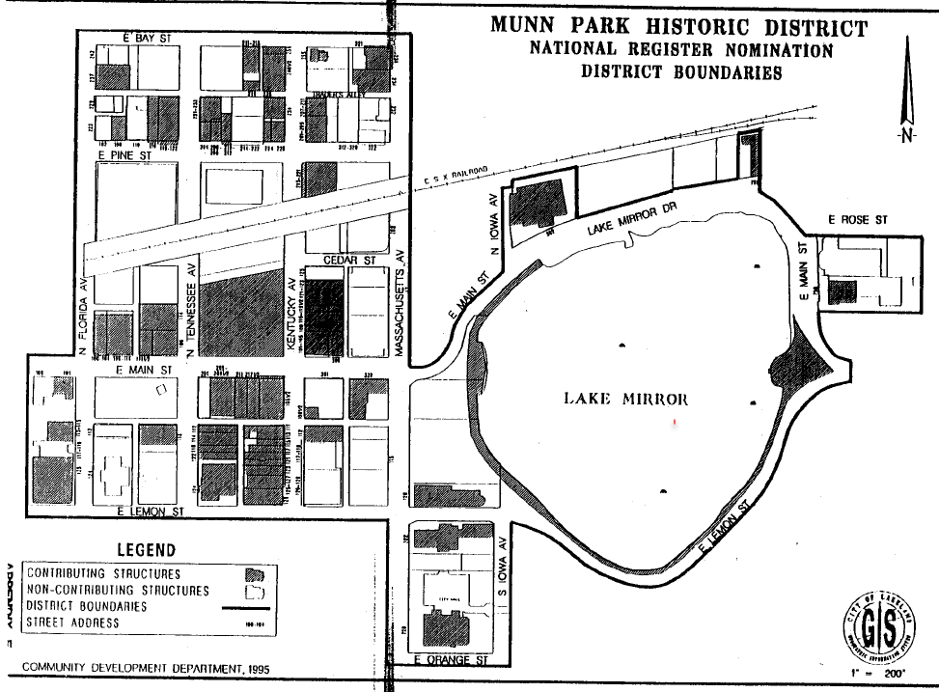
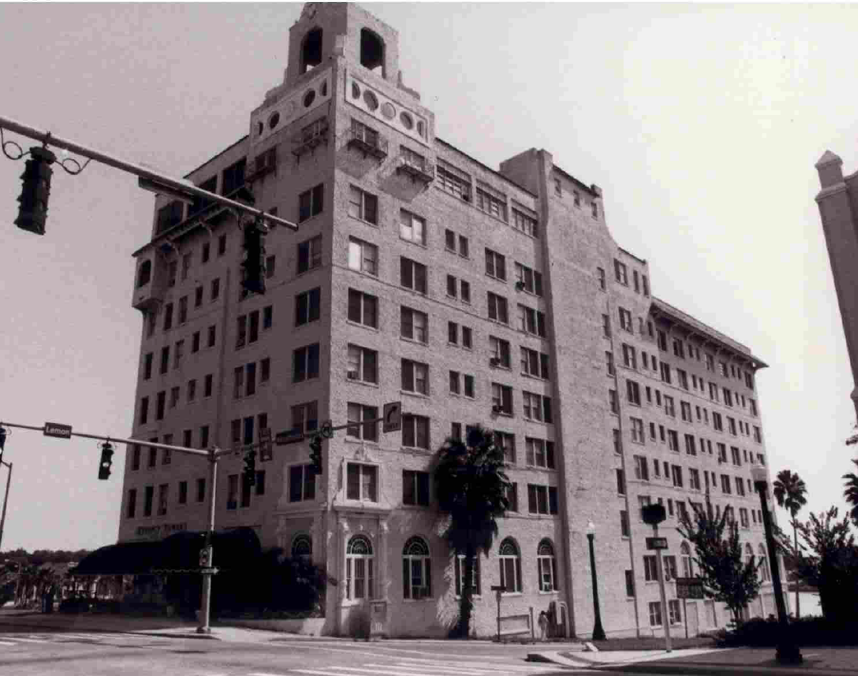
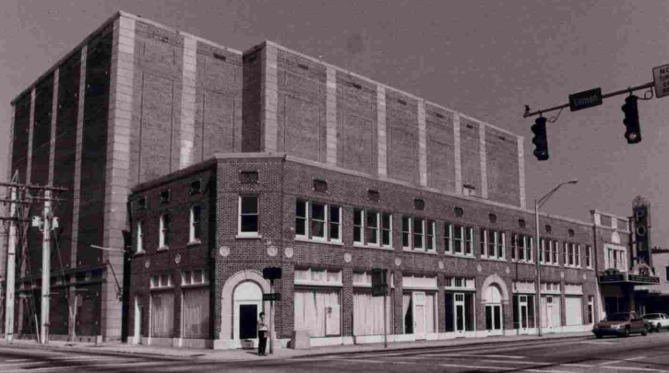
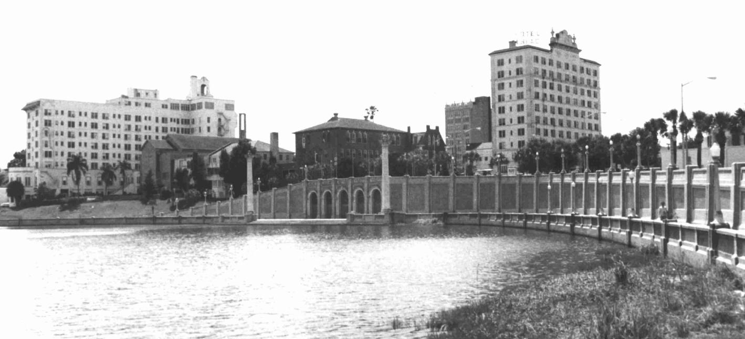
Notes:
In 1997, the Munn Park Historic District was listed on the National Register of Historic Places. The nomination form lists both Munn Park and the Confederate monument as a contributing site and object, respectively, likely due to the age of the monument and the Park’s 1992 restoration. This designation states that the District derives local historic significance from 51 contributing properties, of which 48 are buildings, two are sites, and one is an object, in the areas of Community Planning and Development, Commerce, and Architecture during the period 1884 to 1946. In addition to Abraham Munn’s importance to and influence in founding Lakeland, the District’s historic significance is further attributed to Lakeland’s commercial, governmental, institutional, and cultural development that produced landmark buildings in a variety of historical architectural styles.

Slide 13
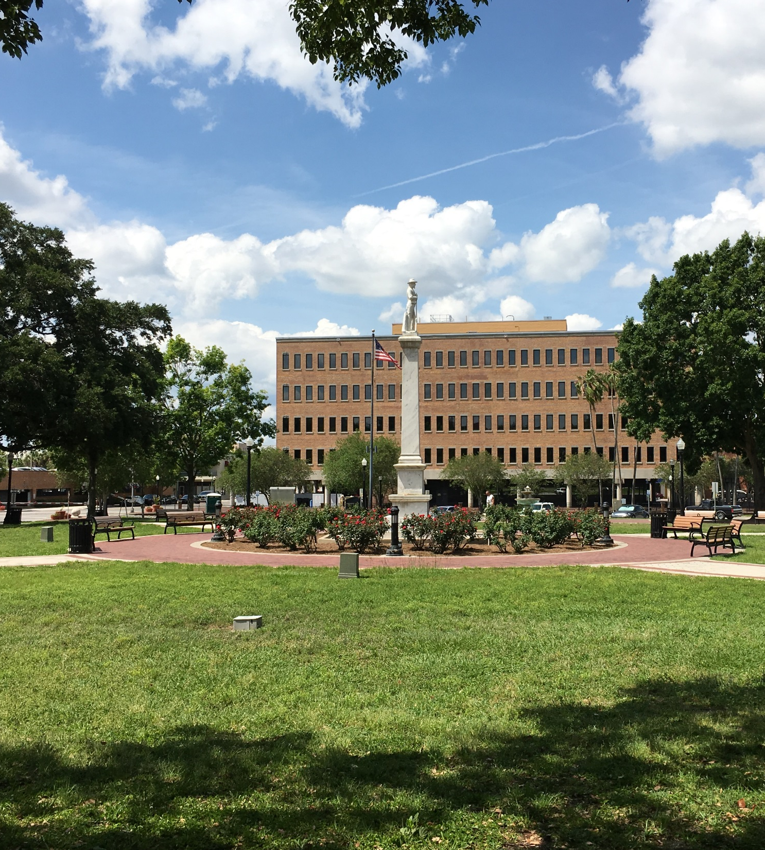
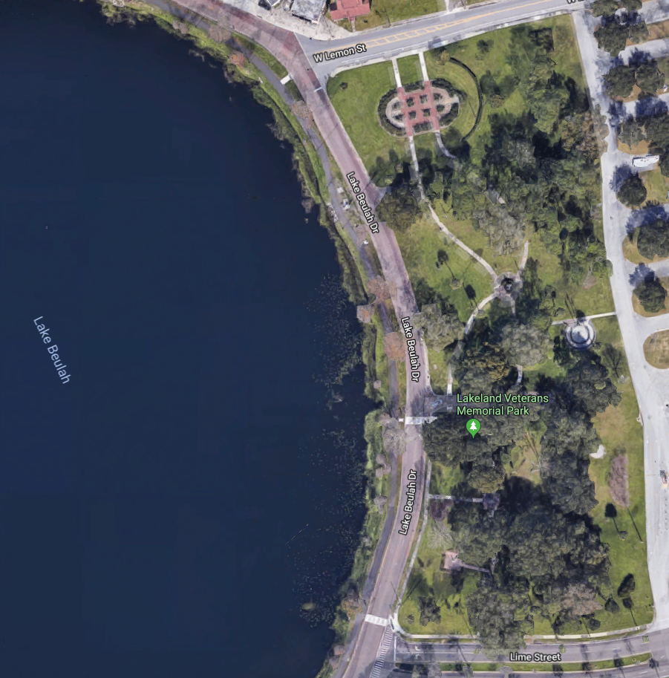
Notes:
Since at least 2015, the Lakeland City Commission has received requests by citizens to remove the Confederate monument from Munn Park. The Commission has also received requests to adopt an ordinance protecting war memorials. Following a public hearing in December 2017, the Commission voted for the Confederate monument to be removed from Munn Park and directed staff to analyze potential relocation sites, costs, and logistics required to move it. On May 7, 2018, the Commission then voted to relocate the monument, intact, to Veterans Memorial Park, a City-owned park east of Lake Beulah.

Slide 14
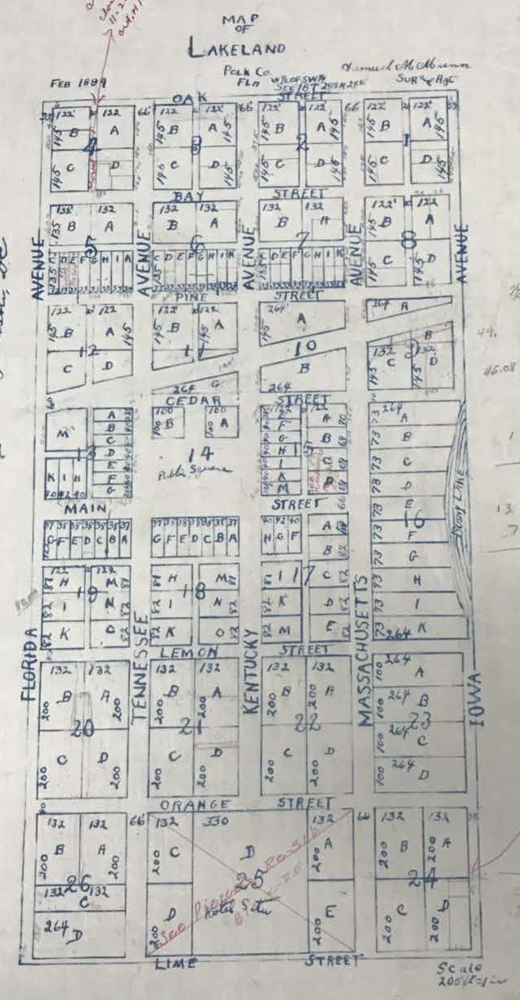
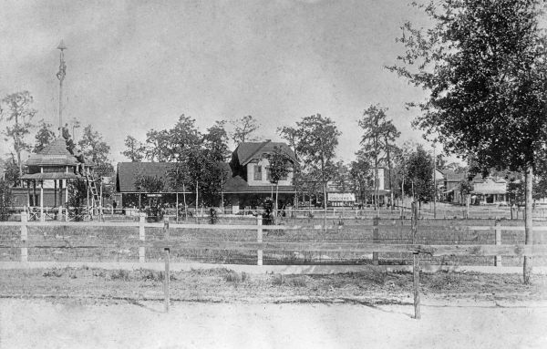
History of Munn Park
1884 Munn’s Subdivision
City Park c. 1889
Notes:
As Lakeland’s first public park, Munn Park has been the City’s “public square” from its inception, as documented in the 1884 Munn’s Subdivision. Lakeland’s founder, Abraham Godwin Munn, dedicated Block 14 in Munn’s Subdivision as a public square to remain forever in public ownership. In 1888, the Lakeland Park Association was formed for the purpose of beautifying the park. Walks were created that bisected the park into quadrants meeting at the center in a circle, trees were planted, and a band shell was constructed.

Slide 15
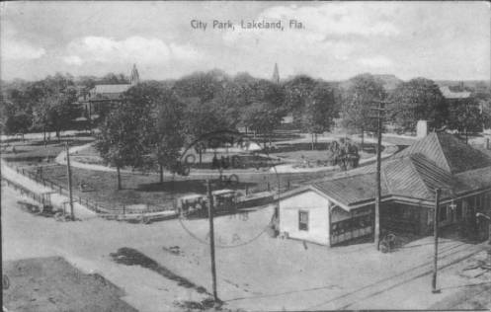
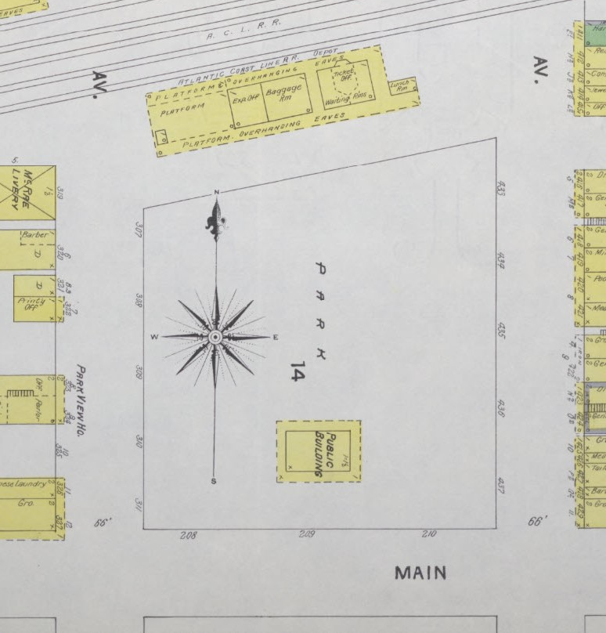
c. 1908 “City Park” Postcard
1903 Sanborn Map
Notes:
A small frame building called the “Pavilion” was built at the southern end of the park, which became the first civic center of the growing town. In 1906, a water fountain donated by Mayor John Cox was placed at the southeast corner of the park. Neither of these structures has survived. Lakeland’s train station was located just north of the park on the railroad, and the park was often the first site visitors would experience upon arrival to the city. In April 1908, the ‘city park’ was formally given the name of Munn Park by Lakeland’s City Council, in honor of Abraham Munn.

Slide 16
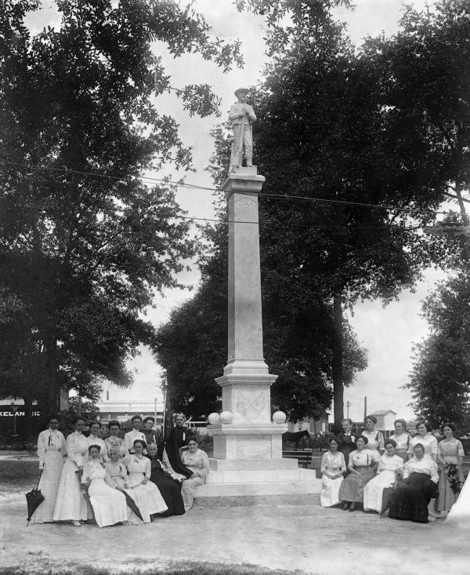
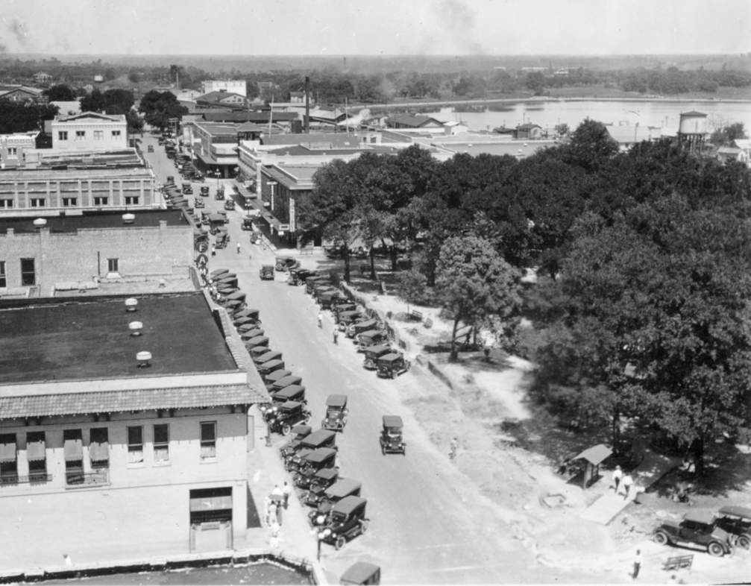
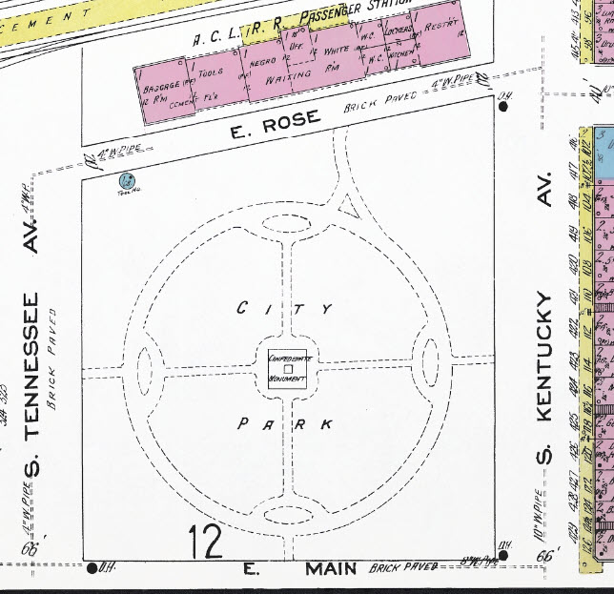
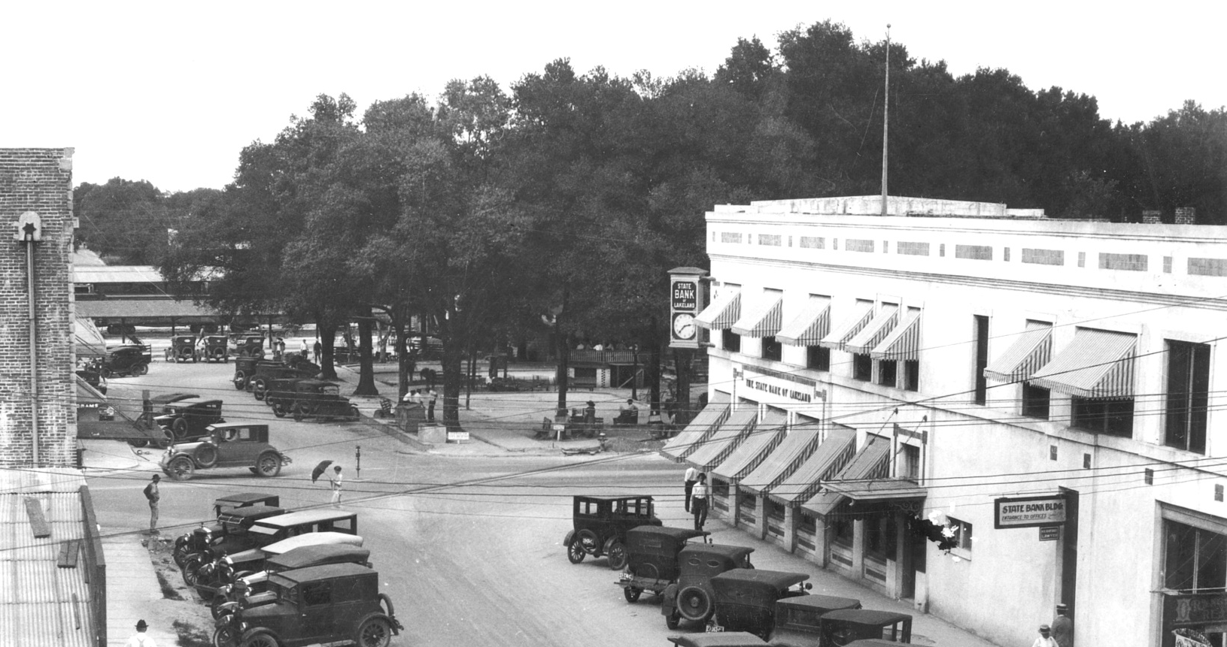
c. 1910
c. 1925
c. 1925
1913 Sanborn Map of Lakeland
Notes:
In 1910, the Confederate monument was erected. As a result of downtown Lakeland’s rapid growth between 1900 and 1925, Munn Park became the focal point of a more sophisticated, urbanizing city.

Slide 17
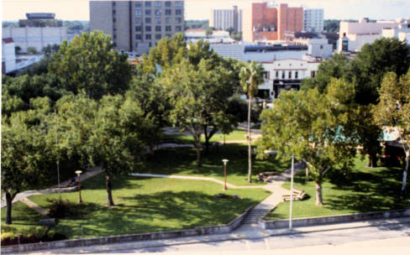
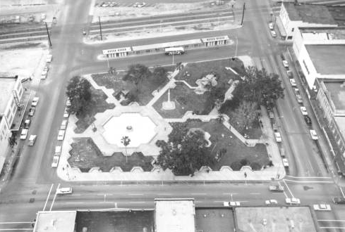
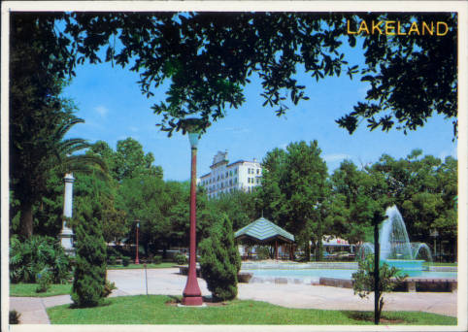
c. 1980s
c. 1962
c. 1980s
Munn Park Renovation 1961
c. 1970s
Notes:
Until 1961, Munn Park remained essentially the same. Bandstands came and went, and the trees grew large. By the late 1950s, downtown Lakeland was a busy and congested commercial center. Redevelopment efforts focused on the demolition of the train station and freight house so that rail traffic would not block downtown streets. Munn Park was also redeveloped in 1961, greatly changing its former round, symmetrical pattern to an angular pattern of walks, and included the installation of a new lighted and musically accompanied “waltzing waters” fountain.

Slide 18
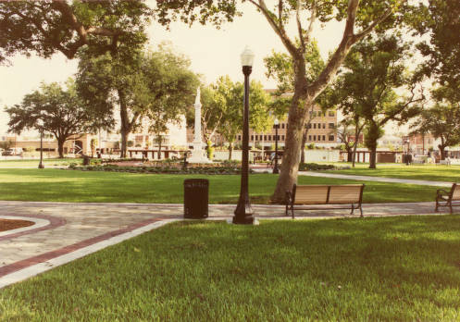
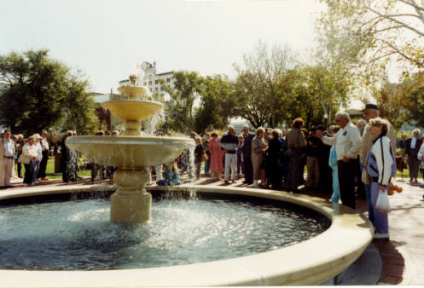
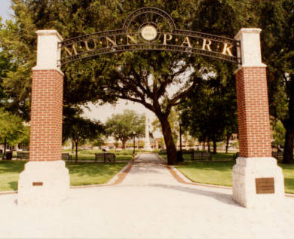
Munn Park Restoration 1992
Notes:
In 1987, efforts began to restore Munn Park to its original configuration. By 1990, the original circular walk was restored and again divided the park into four equal quadrants. The final phase of restoration that extended the north end of the park to its original full size was completed in 1992. The restored Munn Park became the focal point of revitalization within the wider downtown area, which was matched by public infrastructure improvements and private investment in the rehabilitation of nearby historic buildings.

Slide 19
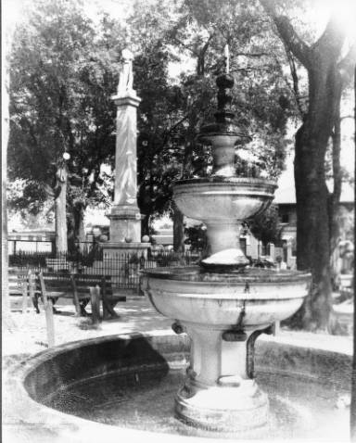
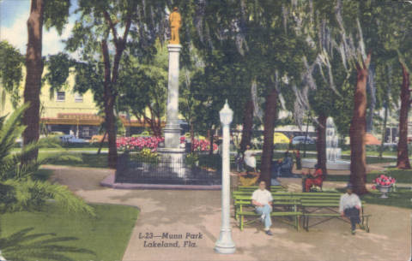
Origins of Confederate Monument in Munn Park
c. 1910
c. 1950s
Notes:
So, going back in time to the origins of the monument… In 1905, the Lakeland Chapter of the Florida Division of the United Daughters of the Confederacy (UDC) decided to purchase a Confederate monument for placement in Lakeland’s public square and collected a petition for its support. Subsequently, the UDC raised funds for the monument’s purchase through a variety of activities, as well as from private donations. The May 25, 1908 Lakeland City Council minutes record the donation of the monument to the City and did not bind it for any unpaid part of its purchase. In June 1908, City Council granted the UDC’s petition to place a Confederate monument in Munn Park. Two years later on June 3, 1910, the Confederate monument was dedicated in Munn Park, on the anniversary of Jefferson Davis’s birth. Purchased from the McNeel Marble Company, the total cost of the monument was $1,750, of which the UDC raised $1,550 and $200 was paid by the Lakeland City Council. Mr. Park Trammell gave the dedication speech, and the monument was formally given to the City and accepted by Mayor W. K. Jackson. Final payment for the balance of the monument was made by the UDC in March 1912.

Slide 20
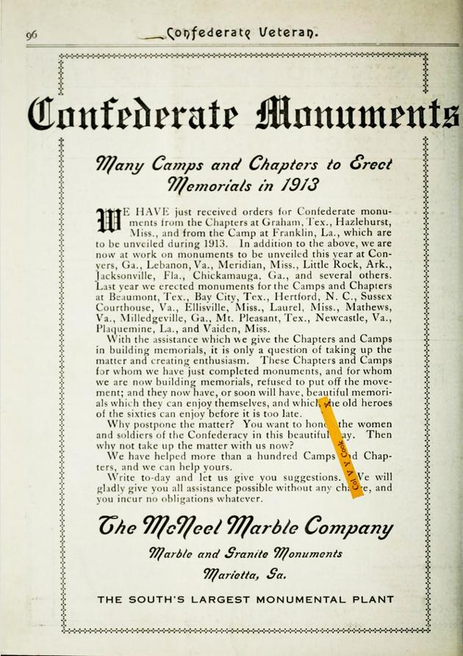
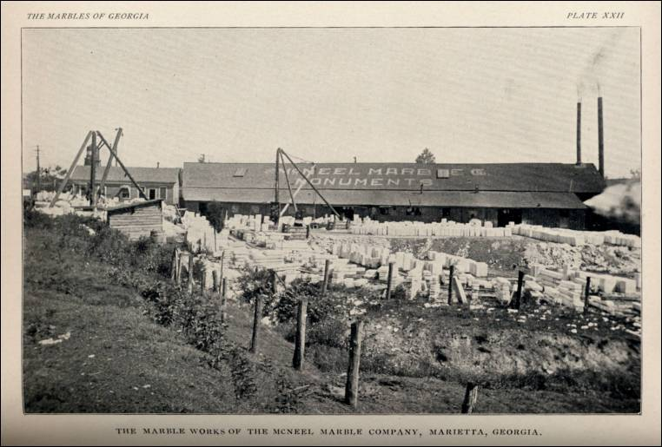
Notes:
The McNeel Marble Company, which manufactured the monument, was incorporated in 1892 in Marietta, Georgia and was a national manufacturer of statuary and stonework. An estimated 140 Confederate monuments were mass-produced by this company and sold mainly to UDC and United Confederate Veterans chapters; in 1909 alone, the company was responsible for producing 95% of all orders for Confederate monuments in the South. Twelve stock soldier designs were used for McNeel monuments. The monument in Munn Park is similar in design to other monuments erected in Florida and Georgia during the same time period. The company closed in 1960.

Slide 21
Applicable Standards
The Secretary of Interior’s Standards for Rehabilitation (“Standards”) are the basis for review for the Munn Park Historic District per the City of Lakeland Land Development Code (“LDC”), Article 11: Historic Preservation Standards.
The following Standards apply to this request:
#2. The historic character of a property will be retained and preserved. The removal of distinctive materials or alteration of features, spaces, and spatial relationships that characterize a property will be avoided.
Notes:
The Secretary of Interior’s Standards for Rehabilitation are the basis for review for the Munn Park Historic District per the City of Lakeland Land Development Code. Standard No. 2 applies to this request: “The historic character of a property will be retained and preserved. The removal of distinctive materials or alteration of features, spaces, and spatial relationships that characterize a property will be avoided.”

Slide 22
Analysis and Findings
1980 City designation of Munn Park Historic District is silent on the status of the monument; lists Munn Park as “intrusion” likely due to 1961 park reconfiguration.
At time of National Register designation, monument had existed in Munn Park for 87 years, meeting the 50-year baseline criterion for designation.
National Register designation of Munn Park Historic District occurred after the restoration of Munn Park.
National Register designation provides little protection to historic resources; Local designation by City ordinance offers protection in form of design review.
Notes:
As the baseline criterion for historic designation on the National Register of Historic Places is 50 years, the fact that the monument had existed in Munn Park for 87 years at the time of the National Register designation of the Munn Park Historic District is likely the reason it was classified as a “contributing object” in this District, and which designation also followed the 1992 restoration of the park. However, the District’s designation by the City in 1980 is silent on the status of the monument and lists Munn Park as an intrusion, likely due to its 1961 reconfiguration. It’s important to note that designation on the National Register identifies resources as being historic, but provides little protection from alteration, relocation, or demolition. The City of Lakeland ordinances designating historic districts and landmarks, in conjunction with the City’s Land Development Code, offer protection for historic resources by way of the design review process.

Slide 23
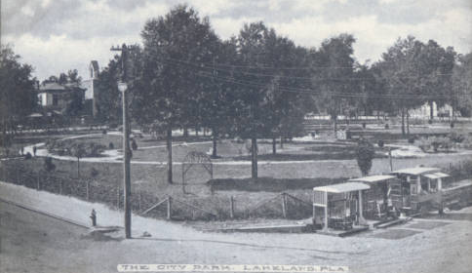
Notes:
Staff finds that Munn Park has been altered several times over its 134-year history, and in this time many structures and objects, including fountains, park furniture, bandstands, landscaping, and public art have been added and removed.

Slide 24
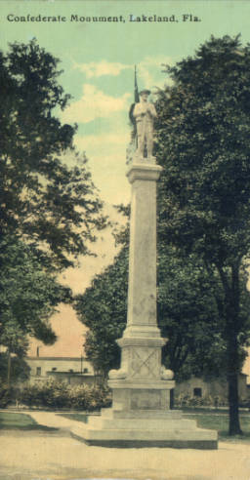

c. 1920
c. 1936
Today
Notes:
Research indicates that the Confederate monument itself has been altered, including the removal of four marble cannonballs on its plinth, as well as a wrought-iron fence that once surrounded it.

Slide 25
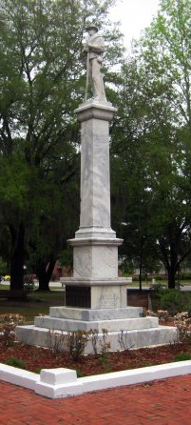
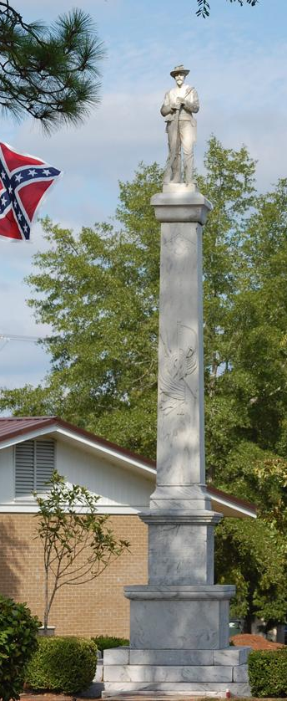
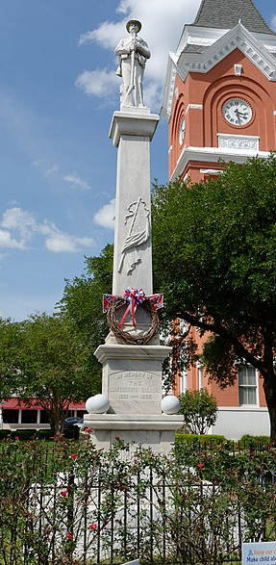
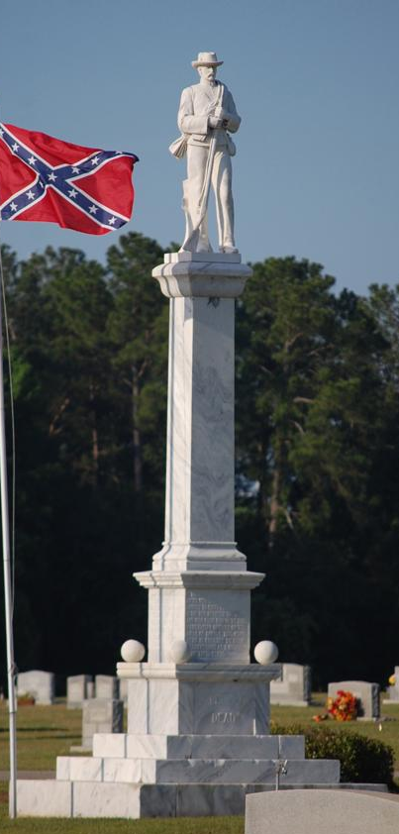
Madison, FL
Eastman, GA
Statesboro, GA
Sylvania, GA
Notes:
Additionally, staff finds that the monument is not unique or of exemplary craftsmanship, and is one of many Confederate monuments mass-produced by the McNeel Marble Company. In fact, the monument is similar to existing monuments in Madison, Florida, and Eastman, Statesboro, and Sylvania, Georgia. Furthermore, the soldier depicted on the monument does not depict a specific Lakeland or Polk County citizen, as it is meant to symbolize Confederate soldiers in general.

Slide 26
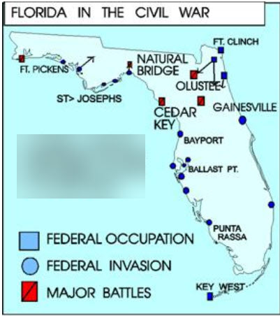
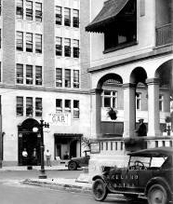
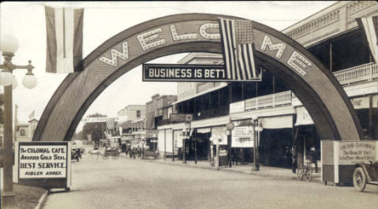
Courtesy www.floridahistory.org
Notes:
The Confederate monument memorializes Confederate soldiers who fought and died in the Civil War (1861-1865), an event which occurred prior to Lakeland’s founding and the dedication of Munn Park to the citizens of Lakeland. While the monument does not contribute directly to Lakeland’s commercial and architectural history, it does connect with local cultural history through its association with the Lakeland UDC Chapter and Confederate veterans who lived in Lakeland. In a broader context, many Confederate monuments reflect an early 20th century perspective of those who experienced the Civil War through stories passed down to them during the long period of reconciliation following it, which led to the Lost Cause narrative of this War. Staff found that no significant events related to the Civil War occurred in the area comprising the Munn Park Historic District. While Civil War veterans from both sides of the conflict were among Lakeland’s early leaders and businessmen who helped shape the downtown, the monument in Munn Park memorializes the history of only one side of this War.

Slide 27
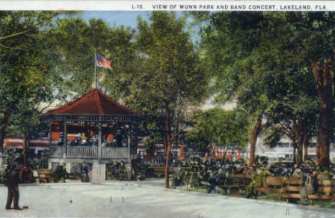
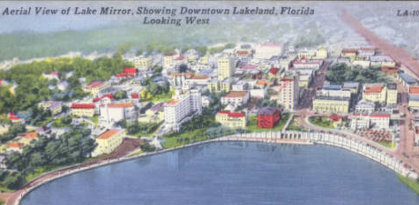
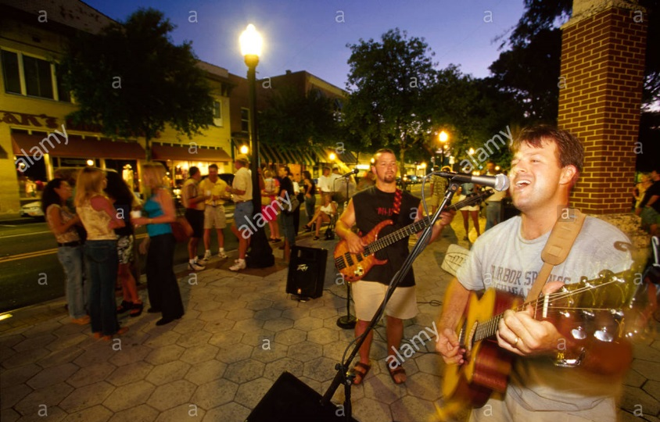

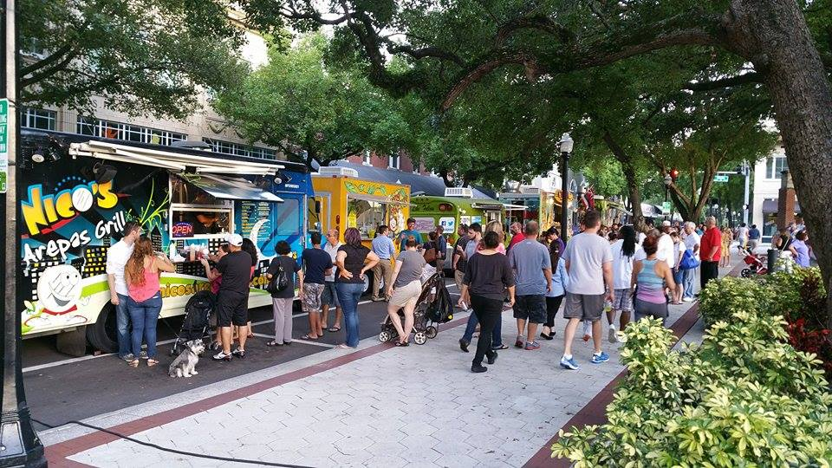
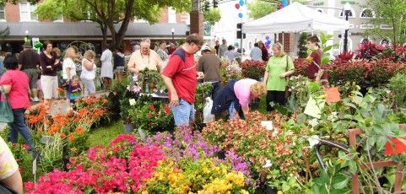
Notes:
Staff finds that the monument does not define or characterize Munn Park or the larger Munn Park Historic District, as the historical context for Munn Park is its purpose as a city square for public gatherings and association with Lakeland’s founding. Additionally, this monument does not directly reflect the historic architecture and commercial context of the Munn Park Historic District, for which the District was recognized as being historically significant; historic significance of the District is attributed to Abraham Munn’s influence and the resulting downtown development that produced landmark buildings in a variety of historic architectural styles from 1884 to 1946. Also, as evidenced by the mass-production of Confederate monuments by the McNeel Marble Company in the early twentieth century, the monument is not a distinctive object. Furthermore, staff finds that removing the Confederate monument from the Munn Park Historic District will not change the overall layout of Munn Park, and that the existing historic buildings surrounding the park that comprise the District’s architectural history will remain unaffected. Therefore, staff finds the removal of this monument will not adversely affect the character or historic or architectural integrity of the Munn Park Historic District.

Slide 28
Staff Recommendation
Recommend approval of the request as submitted.
Notes:
As such, staff recommends approval of the request as submitted. Thank you, Mr. Chairman.

